Slide 1
Cigarette Butt litter awareness
IB - CAS
SDG14 (14.1)
Life Below Water

Slide 2
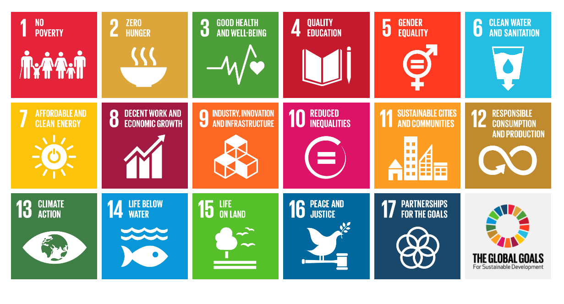

Slide 3
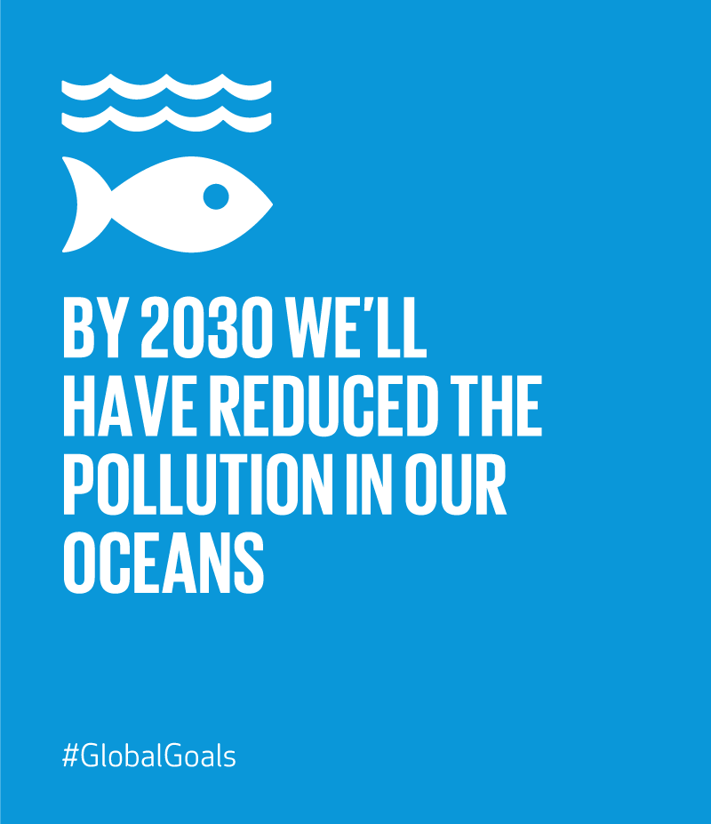
Our Goal
14.1

Slide 4
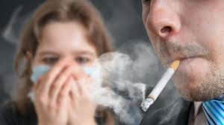
Cigarette Butts are toxic for the smoker
A smoker Inhales
400 chemicals
40 carcinogens
single use plastic

Slide 5
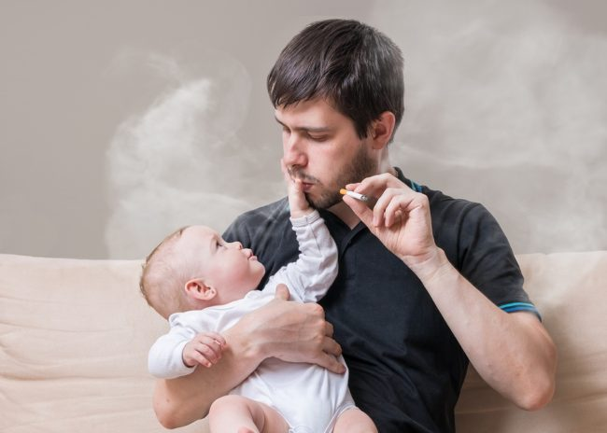
Cigarette Butts are toxic for the passive smoker
A smoker contaminates the air with
400 chemicals
40 carcinogens

Slide 6
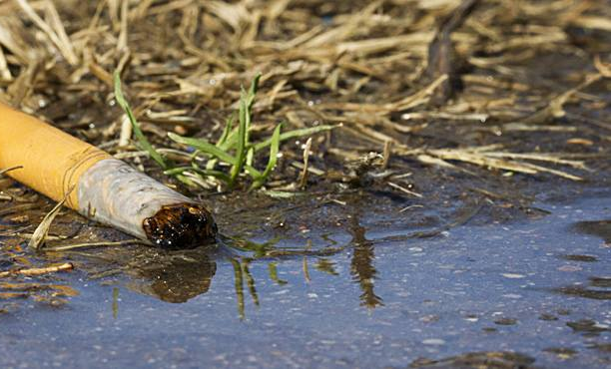
Cigarette Butts litter are toxic for the oceans
When a smoker litters a cigarette butt, it mostly land in the ocean with wind as the carrier
Animals ingest it and get ill
Contaminates the water

