Slide 1
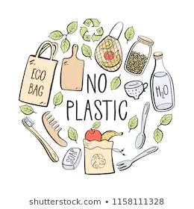
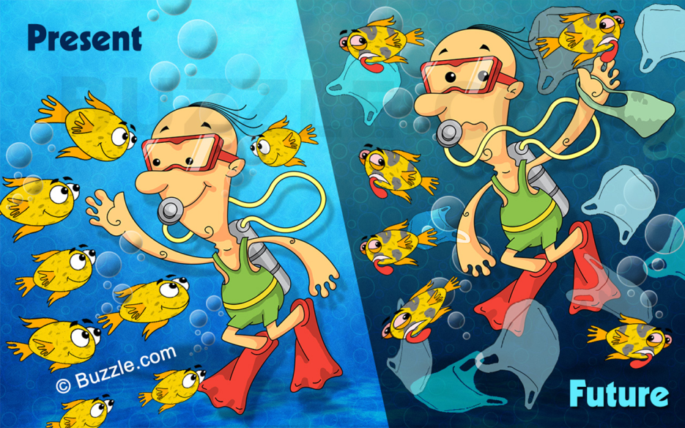
NO MORE USE OF PLASTIC

Slide 2
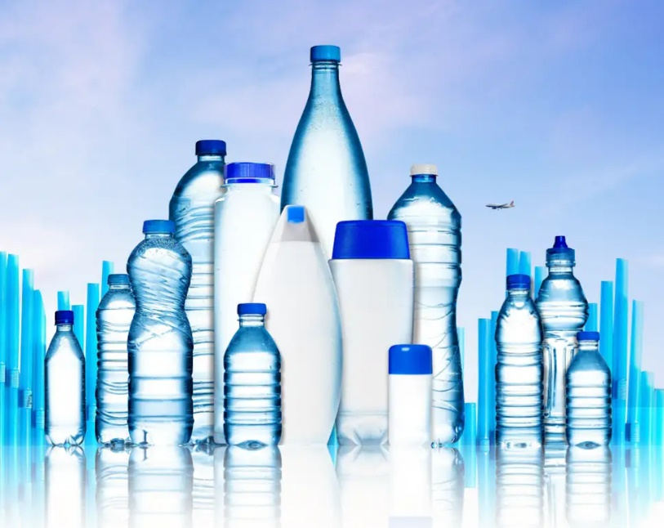
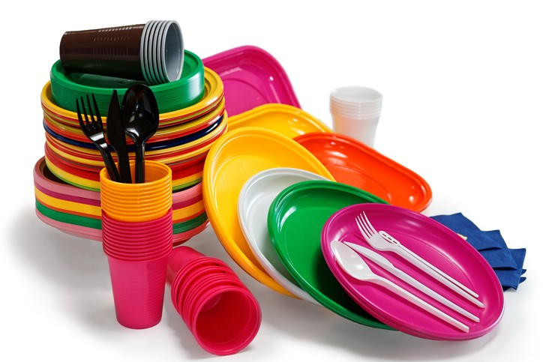
Define Plastic
A synthetic material made from a wide range of organic polymers such as polyethylene, PVC, nylon, etc., that can be molded into shape while soft, and then set into a rigid or slightly elastic form.

Slide 3
Characteristics of Synthetic Plastic
Low weight
High tensile strength
Resistance to chemicals
Non-biodegradable
Lustrous and colorful
Non-conductors

Slide 4
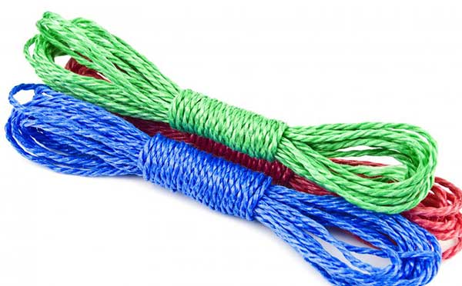
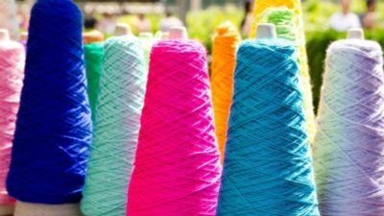
Types of Synthetic Plastic
Thermoplastic = plastics formed by linear arrangement of monomers.
Thermosetting plastic = plastic made by cross-linked arrangements of monomers.

Slide 5
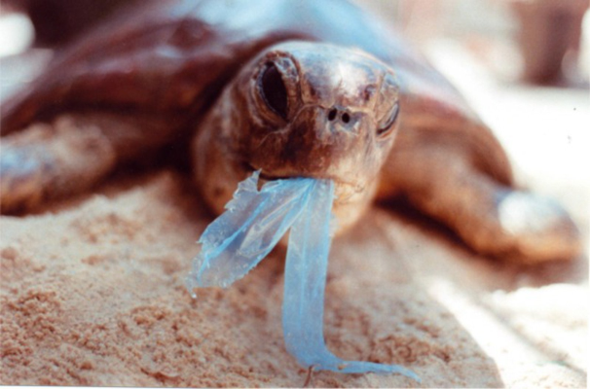
Damage Caused by Plastic Waste
Plastic, if burnt, produce harmful gases which pollute air.
Plastic has toxic pollutants that damage the environment and cause land, water, and air pollution. It can take hundreds or even thousands of years for plastic to break down, so the damage to the environment is long-lasting.

Slide 6
Measures to Control the Damage Caused by Plastic Waste
As a responsible citizen we need to remember the 4 R’s principle:
R= reduce, reuse, recycle, recover
We need to develop habits that help to preserve the environment.
Reuse. Bring your own reusable shopping and produce bags to markets, and avoid using single-use plastic bags....

Slide 7
YUVAIN
CLASS- VIII B
HANSRAJ MODEL SCHOOL, PUNJABI BAGH
NEW DELHI

Slide 8
THE END THANKYOU!

