Slide 1
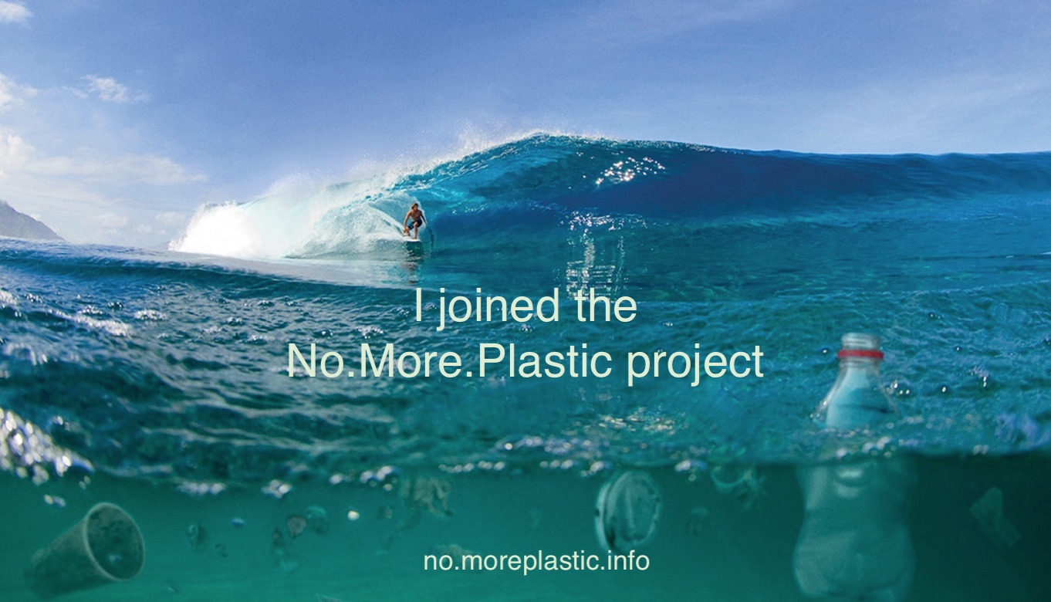
Colegio Las Cumbres Ciudad de Buenos Aires ARGENTINA

Slide 2
WHAT´S THE PROBLEM? We observe the image and describe what we see, think and wonder
Thinking routines
We wonder…..

Slide 3
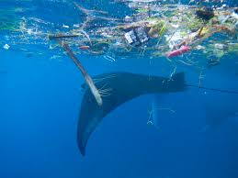
What are Microplastics?
Microplastics, small pieces of plastic, less than 5 mm (0.2 inch) in length, that occur in the environment as a consequence of plastic pollution. Microplastics are present in a variety of products, from cosmetics(microbeads) to synthetic clothing to plastic bags and bottles. Many of these products readily enter the environment in wastes.

Slide 4
Which are the ways in which microplastics enter the environment?
There are three ways in which microplastics enter the environment
1- through the disintegration of bigger pieces of plastic
2- through our clothes
3- through the use of cosmetics with microbeads

Slide 5
Which countries are most affected by microplastics?
China is the country which produces more microplastic waste, at 8.8 metric tons, and this is a consequence for being the most populous country in the world. Although most of this plastics end up in the oceans around China, microplastics have found their way into China’s rivers and lakes. Indonesia is the second most affected country by microplastics, at 3.2 metric tons. Microplastics in Indonesia affected both her oceans and rivers. Moreover, four of Indonesia’s rivers rank among the 20 most polluted rivers in the world. The Philippines come at third for microplastic pollution, at 1.9 metric tons. Microplastic pollution in the Philippines is mainly caused by single-use plastic sachets and lack of government involvement in this issue.

Slide 6
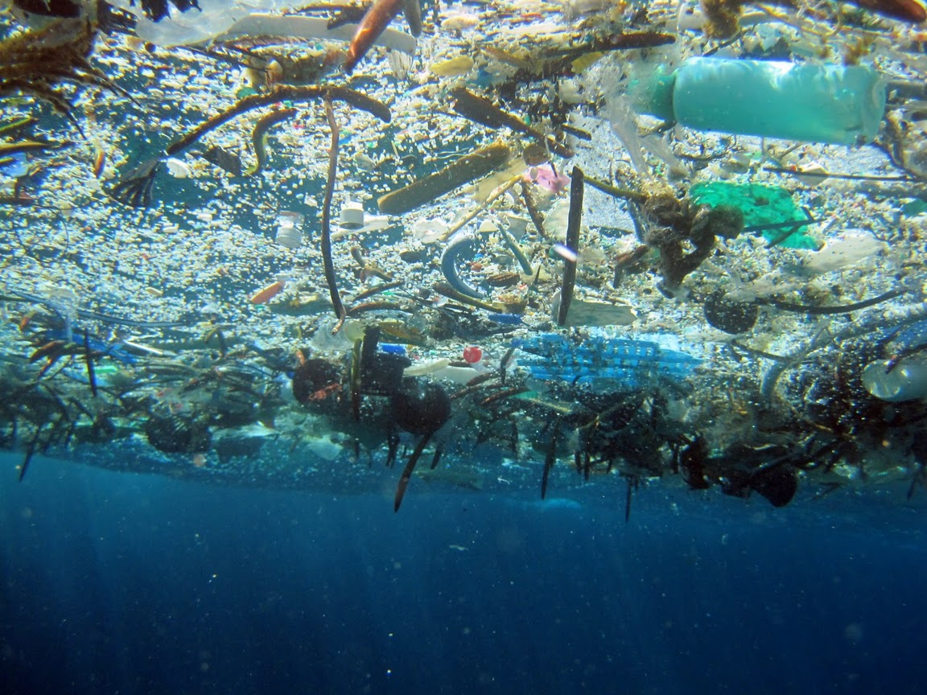
What is plastic soup?
Plastic soup is a term used to refer to pollution of the seas and oceans by plastics. These ones go from larger to smaller pieces. All these different types of plastic together form the term known as plastic soup. Plastics come either from the rubbish we throw away every day, fishnets and more. This is considered as a problem that affects the entire world and that should be solve.

Slide 7
Plastic soup; It’s consequences
Imagine Russia made of plastic; Our plastic waste has created a gigantic “plastic soup” in the Pacific of up to 15 million square kilometers - almost the size of Russia.
The Sea Education Association (SEA) expedition to the western North Atlantic Ocean found bits of HDPE (high density polyethylene), LDPE (low density polyethylene), and PP (polypropylene) from items such as milk containers, plastic bags, and straws, which float on the surface.

Slide 8
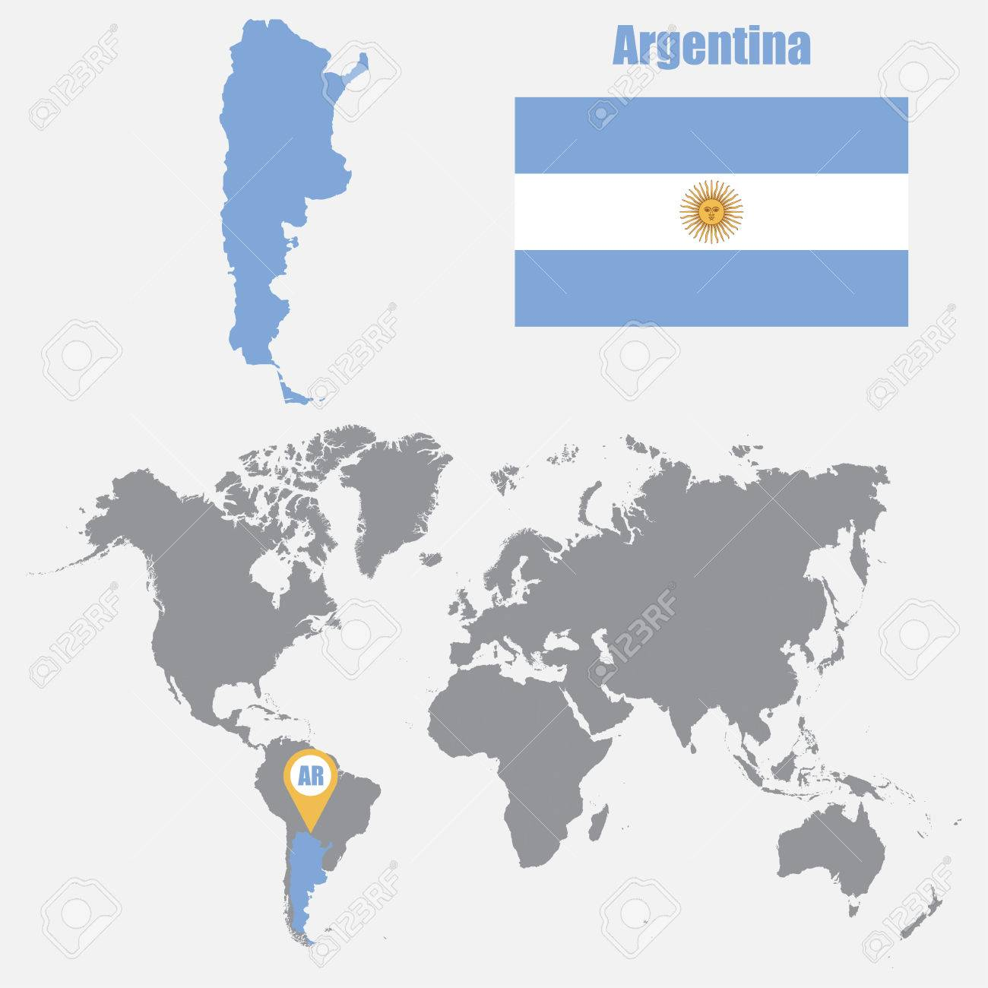
What’s the problem in Argentina?

Slide 9
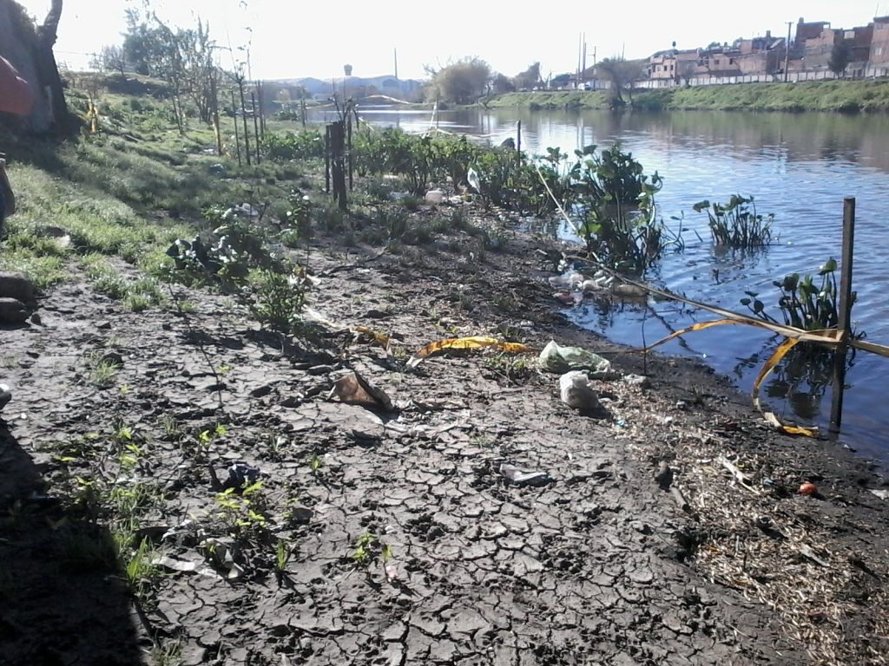
Plastic soup: An example of plastic soup is the Matanza river, better known as `riachuelo´. Picture:Gabriel Basílico.

Slide 10
Effects/consequences in humans
3,000 industrial establishments, aimed at later human consumption, are located all along the basin. All along the 15 municipalities that are on the coast of the Riachuelo, where there are more than 100 open dumps and the water has levels of mercury, zinc, lead and chrome.
Surrounding the villa 21-24 of Barracas, there is a plastic soup, where a study was made on 962 children under 6 years, and the 25 percent has blood lead according to all agencies and official representations.

Slide 11
Effects/consequences in nature and animals

Slide 12
Single use plastic https://lessplastic.co.uk/9-reasons-refuse-single-use-plastic/

Slide 13
Effects/consequences in humans
- Contamination: which affects humans health and survival.
Only 225,000 tons recycled per year on total consumption of 1,613,000 tons of plastics bags, which causes pollution.
-Humans consume plastic bags which later will go to the oceans. Plastic bags are the main problem in Argentina because it contaminate all the streets and oceans, resulting in the death of many animals, and the decrease of life expectancy.
The quantity of plastic bags that are produced it defines at a level in which the social costs equals the social benefits as the value that society places on the last unit produced will be equal to the full cost of producing that last unit. This would then mean that there will be a socially efficient level of production or socially efficient output for the plastic bags when resources are efficiently allocated.

Slide 14
Effects/consequences in nature and animals
There was a National research in Argentina by the Coastal Waste Census, 82% of the inorganic waste was found on the sands of the coasts of Buenos Aires, which corresponded to plastics and within that percentage plastic bags were detected.
Plastic pollution is harmful to birds and other wildlife.
At world level, 200 kilos of plastic are thrown into the ocean per second and Argentina ranks 28th on the scale of polluting countries.
Several pictures and researches has proved that the the plastics end up in the stomachs of marine animals that, when mistaken for food, eat them and, as a consequence, die or makes it impossible for humans to eat them.

Slide 15
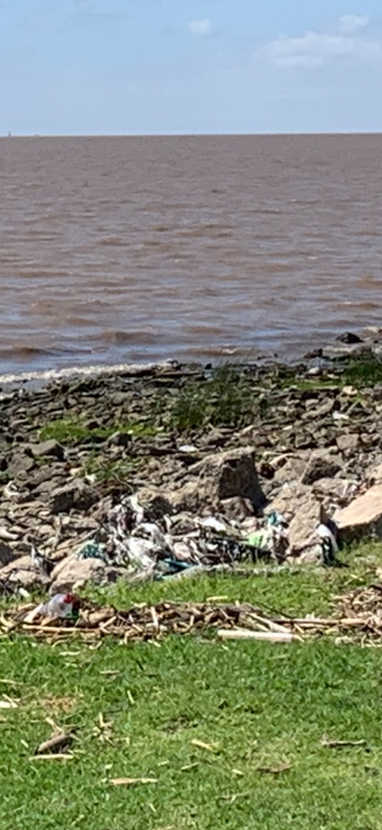
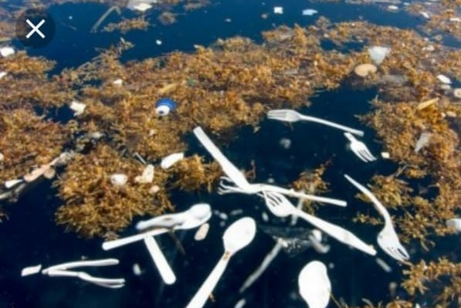
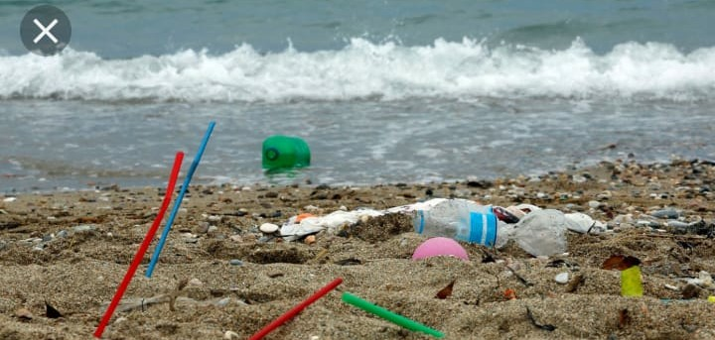
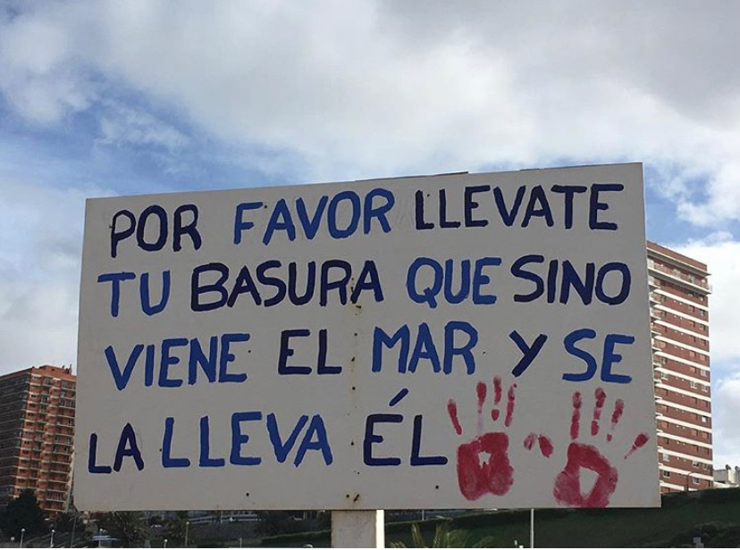
River coast in Vicente López
Buenos Aires
Playa Grande, Mar del Plata
Buenos Aires

Slide 16
MICROPLASTICS: Effects/consequences in humans
Analía Perez, a researcher at the Conicet (Maimónides University), that works with species obtained from the Beagle Channel, located in Tierra del Fuego said: "What we did so far was to evaluate some invertebrates and vertebrates. The preliminary study we did allows us to ensure that 100% of the animals analyzed had microplastics. "
The study dealt with different kinds of fish, which humans in Argentina consume daily, such as pejerrey or surubí, which led to the conclusion that, consequently, humans also consume microplastics.
Microplastics have not only been found in foods directly consumed, but also in condiments such as table salt.
Researches in different provinces have proved the existence of microplastics in diverse mineral water bottles, the ones humans consume everyday.
Although the risks of microplastics in humans has not yet been a highly developed area, the presence of these in seafood products have consequences for human health due to the body's exposure to the additives and contaminants of these components.

Slide 17
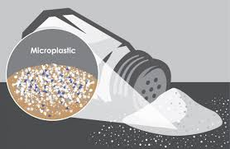
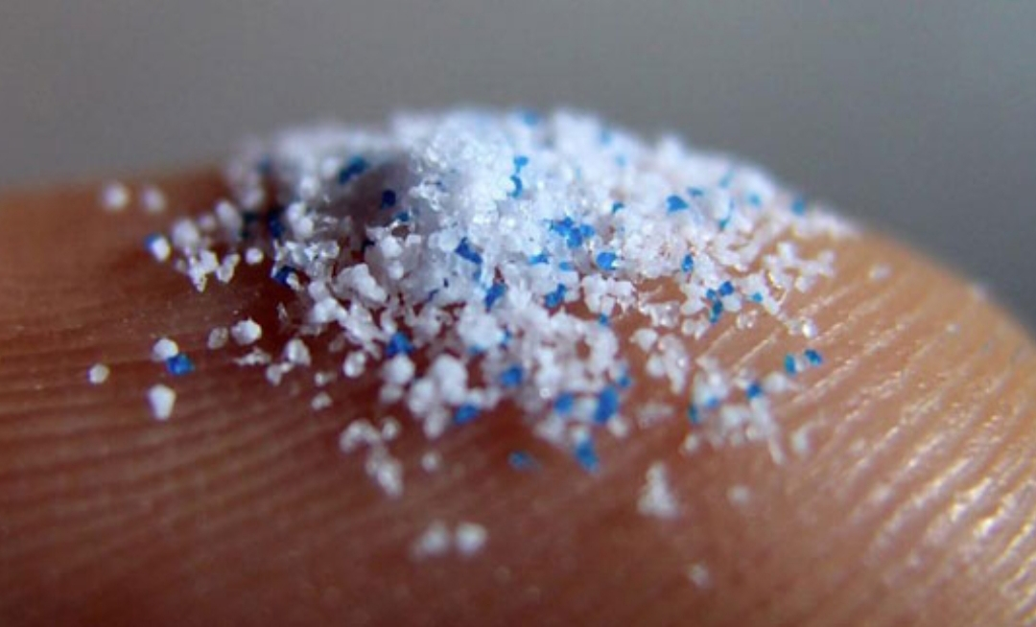
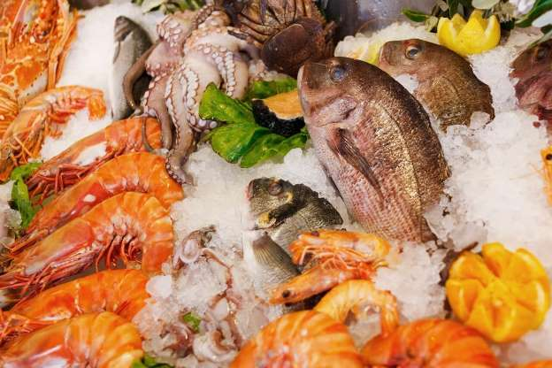
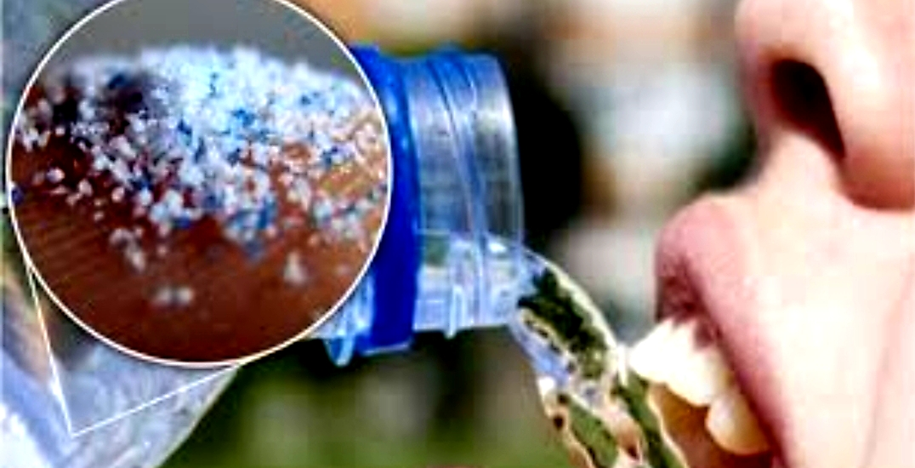

Slide 18
Effects/consequences of microplastics in animals
Argentine scientists found in the beagle channel and the Atlantic coast approximately 100 microplastics for each liter of water.
Microplastics are actually the most dangerous plastics for the environment. They are the biggest cause of global warming in our country, and consequently, of pollution and climate change; a cause that moves masses of people who march to revert these alarming numbers.
Remains of microplastics waste have been found in animals all throughout the Argentinian's coast.
Argentina is among the top 30 countries (out of 200 surveyed) that produced more microplastics in the ocean, thus being a significant source of pollution.
It was substantiated that microplastics in animals produce alterations in their digestive system and even intestinal obstructions that can lead to death, especially in small marine organisms.

Slide 19
