Slide 1
#NoMorePlastic

Slide 2
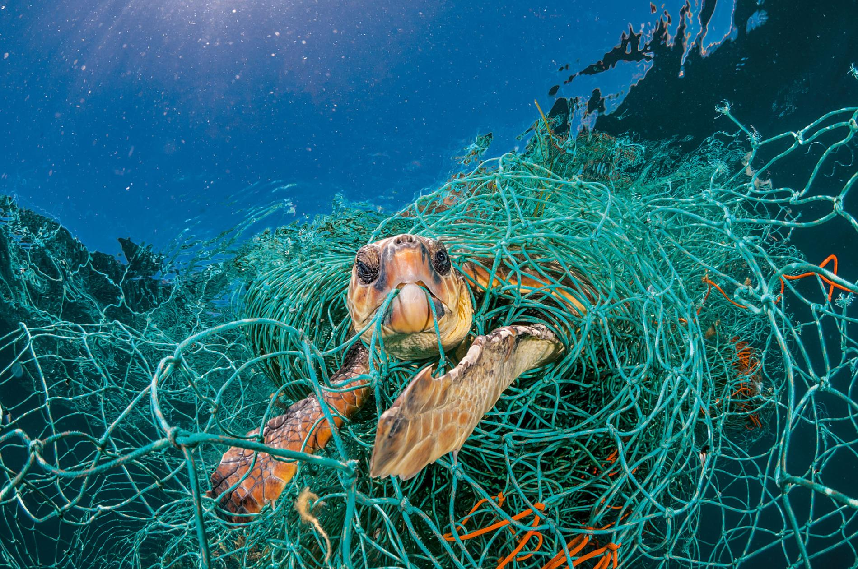
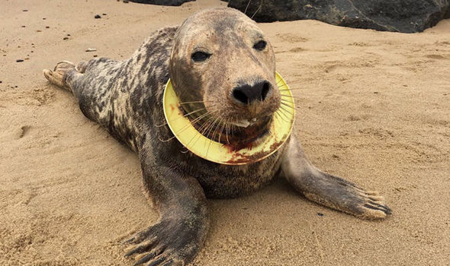
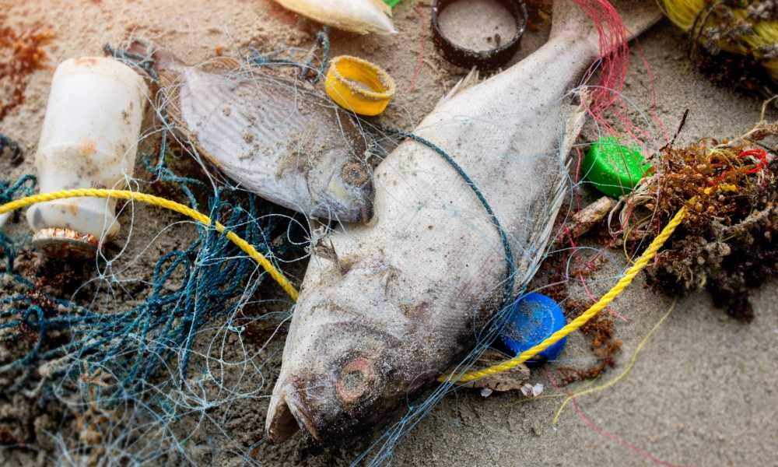
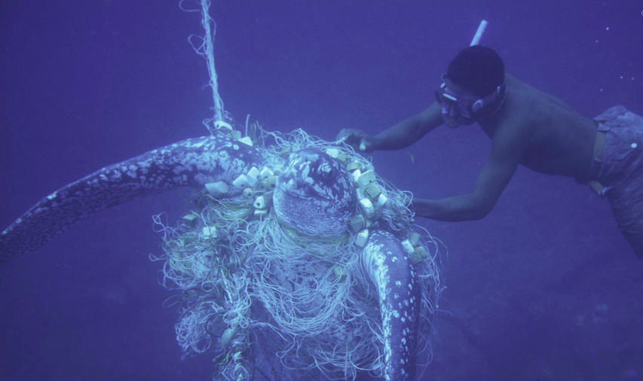
Marine Life
Notes:
Our actions are destroying the natural ecosystem
Occupying less than one percent of the ocean floor, coral reefs are home to more than twenty-five percent of marine life.

Slide 3
Why should we care?

Slide 4
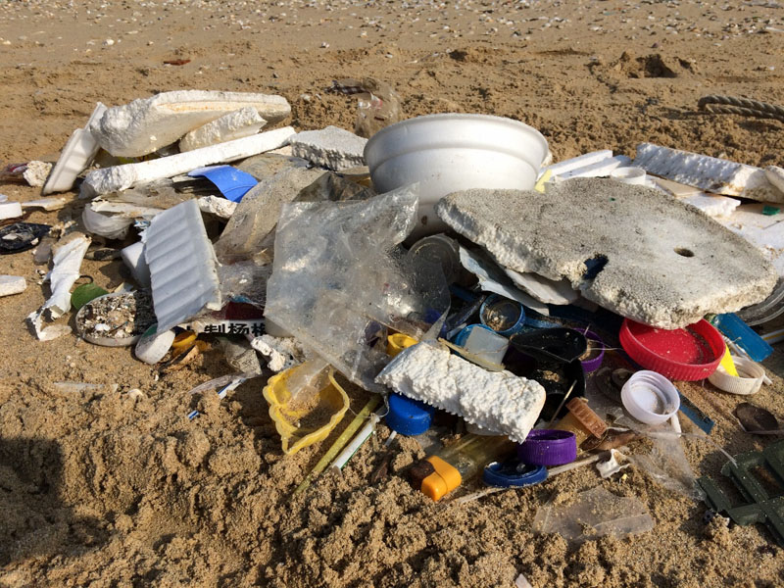
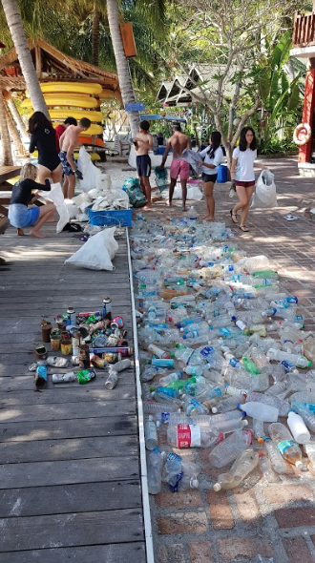
Beach Cleanup
Pulau Seribuat:
588 plastic water bottles
Over 56 kg of rubbish collected
Notes:
This was just on one beach on one Island in Rawa, what if we told you this was taking place on a much larger scale, there is an area on the planet where 87000 tonnes of plastic floats, this is known as the ‘Great Pacific Garbage Patch’, and it sits in the middle of the Pacific Ocean, to put it into perspective it is the size of Texas.

Slide 5
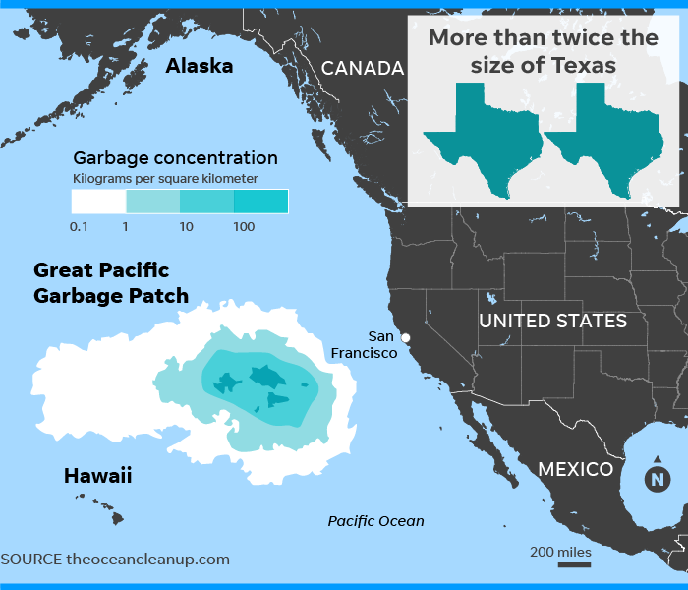

Slide 6
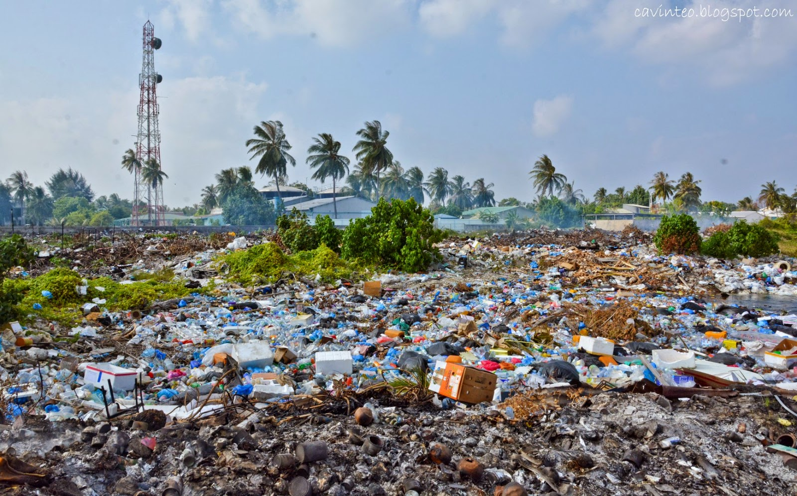

Slide 7
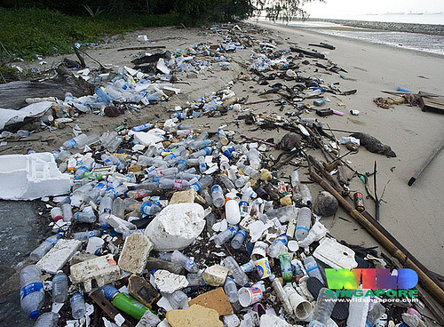

Slide 8
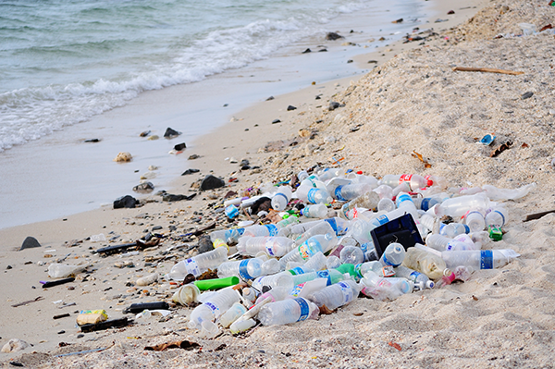

Slide 9
Recognise some of the pictures?
“Out of sight, out of mind”

Slide 10
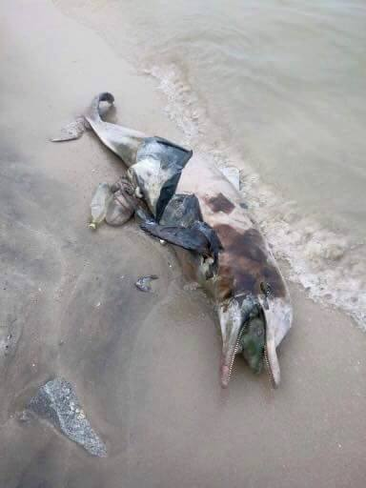
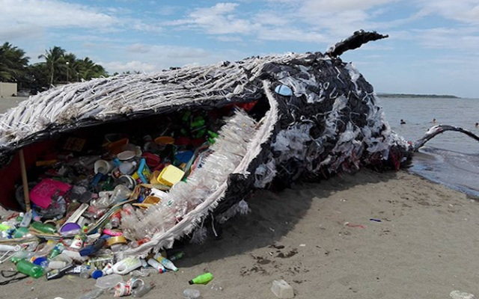

Slide 11
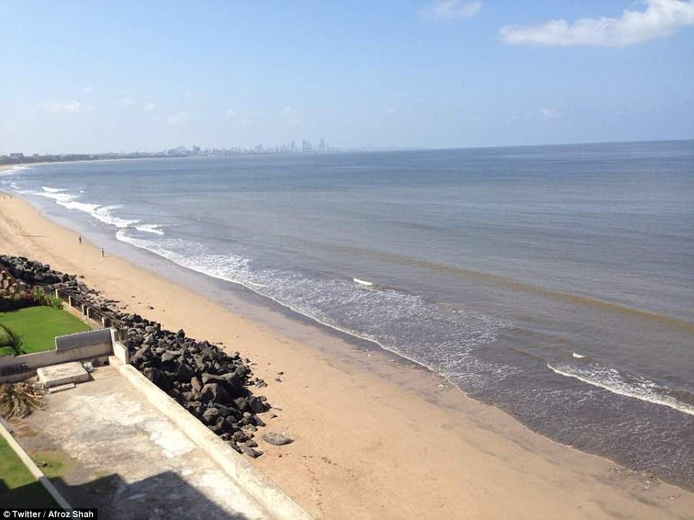
Notes:
Versova beach, Mumbai

Slide 12
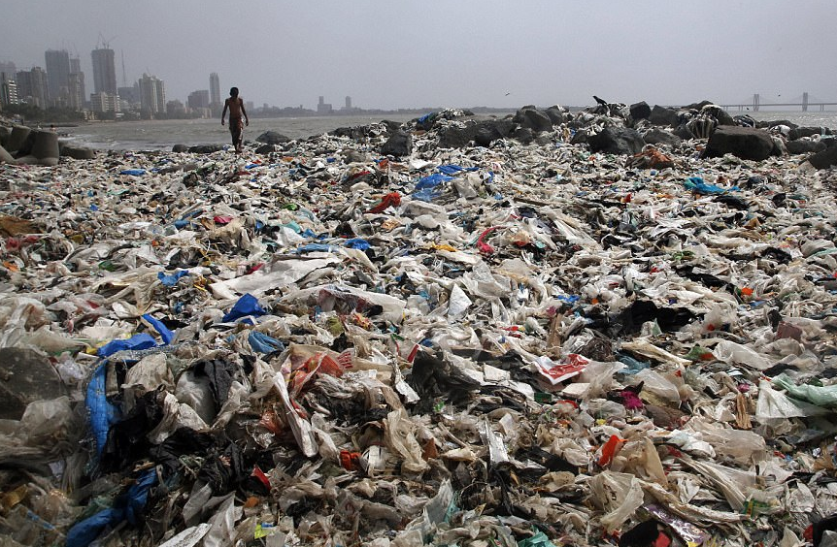

Slide 13
What can we do about it?
Notes:
Well there are actually many ways you can reduce your plastic usage in MCM and at home, these are all things you can easily do, which when carried out by many can have an immense impact on the amount of plastic we waste.

Slide 14
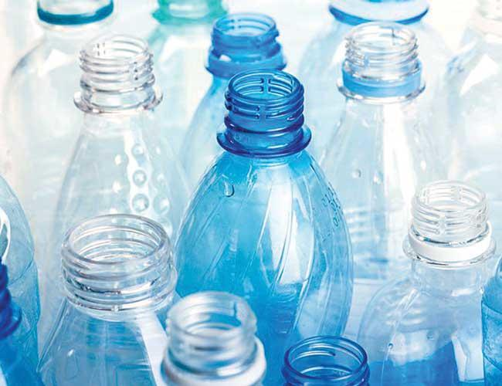
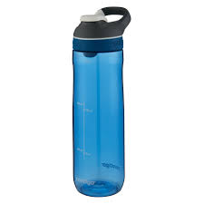
Use reusable water bottles!
Notes:
Every minute, 50,000 single-use plastic bottles are out to waste in the US alone, if we keep this up, in 2050 there will be more plastics than fish in the ocean.
From simply using one reusable water bottle, you could save yourself from using 167 water bottles a year.

Slide 15
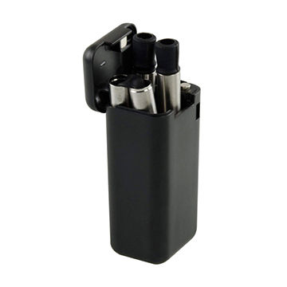
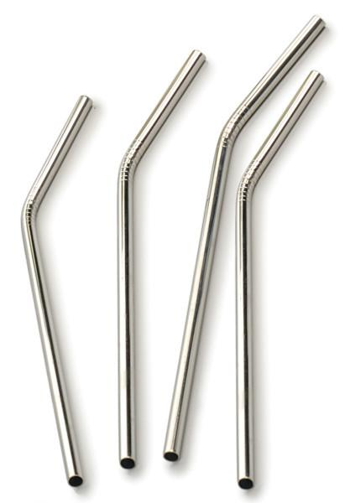
Stop using plastic straws!
Notes:
500 million plastic straws are used every day in the US alone, and only a very small proportion of these are recycled.
Even in restaurants. If you really need to use to a straw, purchase a reusable stainless steel or glass straw, nowadays they are easily accessible to buy and store.

Slide 16
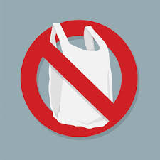
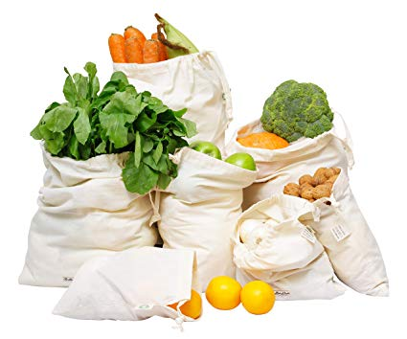
Say no to plastic bags!
Notes:
5 trillion plastic bags were used last year and less than 1 percent were recycled.
Next time you go grocery shopping refuse to take plastic bags and instead bring your own reusable bag, again these are very accessible and can save you from having to use countless plastic bags.

Slide 17
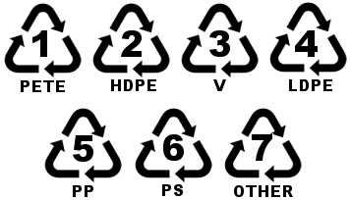
Recycle your plastic products, put them in specific bins to be recycled!
Notes:
Of the 30 million tons of plastic waste generated in the US every year, only 7 percent was recovered for recycling
If the piece of plastic has one of these triangles on it, then it can be used for recycling.
When sorting materials out to be recycled, make sure everything in that specific bag is strictly recyclable, as lets say even one piece isn't, the whole bag can’t be used for recycling.

