Slide 1
Say No To Plastic Bags
The impact of plastics on the environment

Slide 2
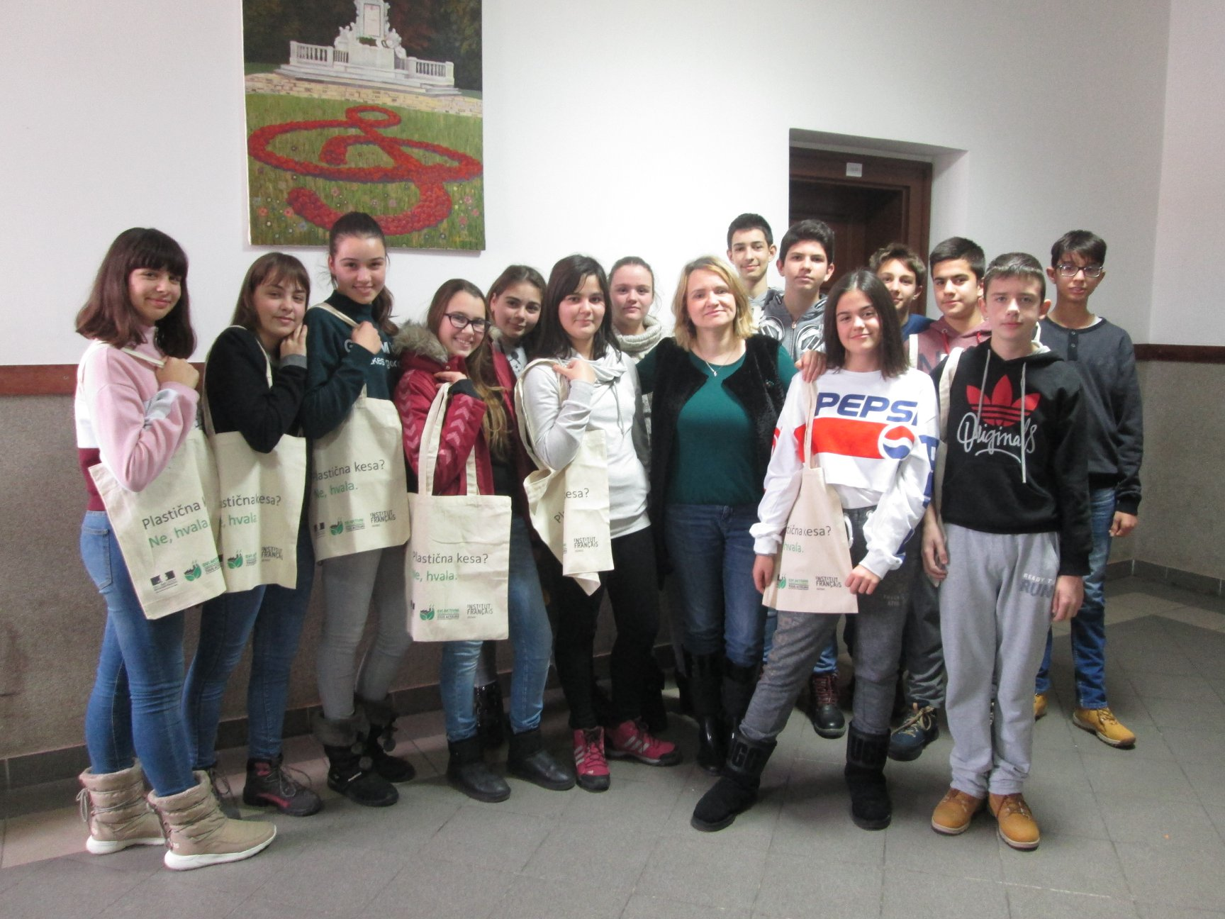
Our Conclusion
On the photo you can see my students' awareness that plastic bags should be ejected from use during everyday shopping. They are wearing canvas bags when they go shopping instead of plastic bags that can be obtained in the markets.

Slide 3
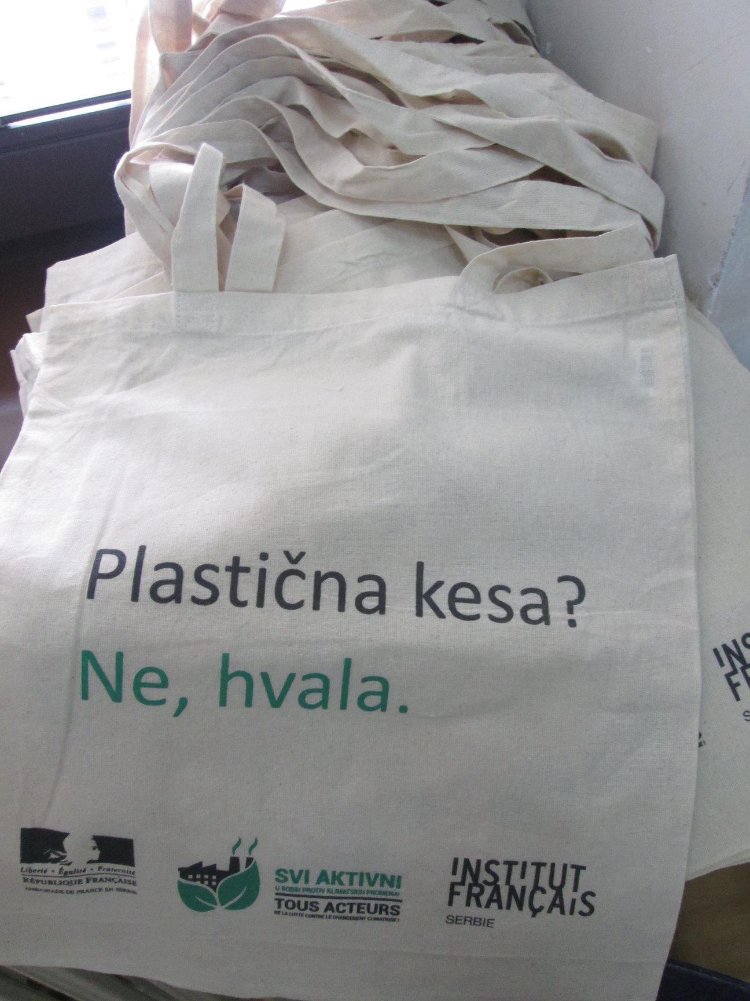
Let’s act!
The key line is written on their canvas bags for purchase: "Plastic bag? No, thanks.“ Let’s all do it!

