Slide 1
SOLUTIONS TO PLASTIC POLLUTION

Slide 2
Altering Human Activities

Slide 3
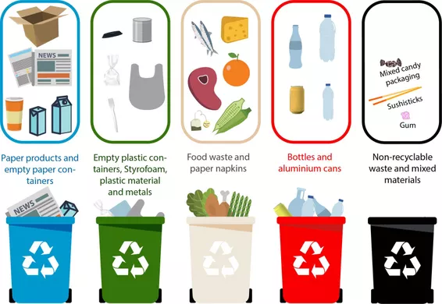
Solutions to plastics: Recycling Plastics & Separating Residues (Mora)
PET plastics are usually coded with the identification code number "1" inside the universal recycling symbol, usually located on the bottom of the container.
PET is one of the most common consumer plastics used.
PET is used as a raw material for:
making packaging materials such as bottles and containers.
Examples include soft drinks, alcoholic beverages, detergents, cosmetics, pharmaceutical products and edible oils.
making lower grade products, such as carpets.

Slide 4
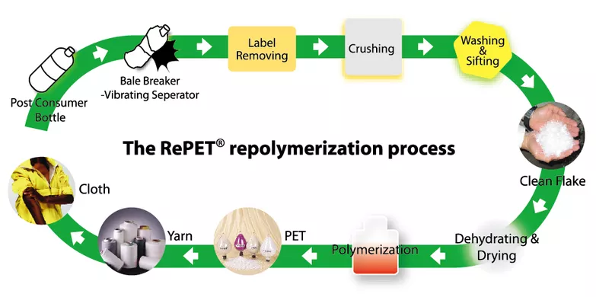
How does PET work?
The empty PET packaging is discarded by the consumer, after use and becomes PET waste.
Dog raincoat made from 100% recycled PET fabric.
OPTIONS:
PET waste is reprocessed (grinded, melted and reformed).
PET waste is then chemically treated where each component is isolated and reprocessed on its own and used in future manufactures.
Pet waste is incinerated to generate energy.

Slide 5
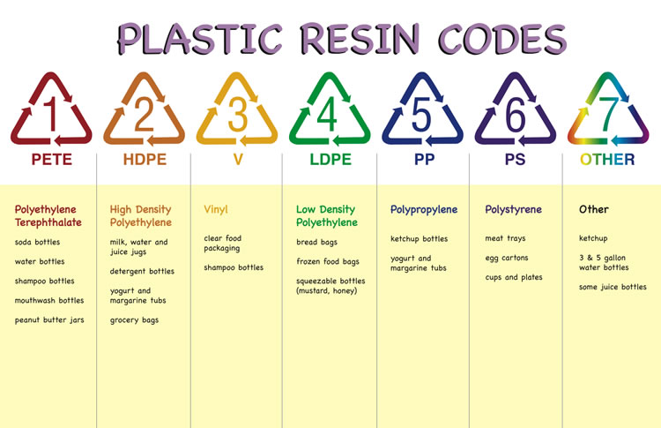

Slide 6
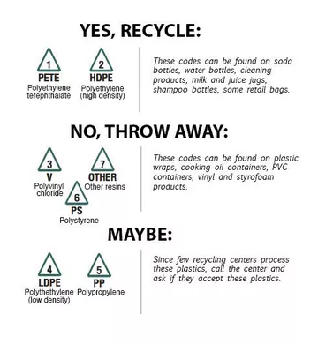
Which types can I recycle?

Slide 7
Ways to recycle (Mora)
Reuse Plastic Bags: use several times the plastic bags you already have (for example to do future groceries and a garbage bag).
Buy Rechargeable Batteries: Batteries are filled with toxic materials that are terrible for the environment. Buy ones that can be reused/recharged. Recycle the non-rechargeable batteries that you already have.
Recycle at school: Buy recycling bins.
Start supporting eco-friendly companies by buying products made from recycling material (paper, wallets, clothing, etc).
Don’t throw away old electronics: Find the nearest electronics recycling depot. They can recycle from laptops to phones.
Compost: use your organic matter waste to make fertile soil. Reduce your trash.

Slide 8
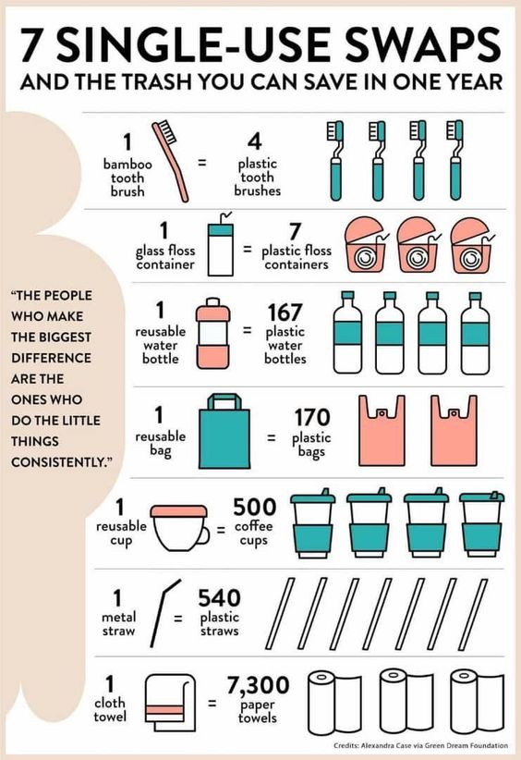
Eco-friendly Swaps.

Slide 9
CONTROLLING THE RELEASE OF POLLUTANT

Slide 10
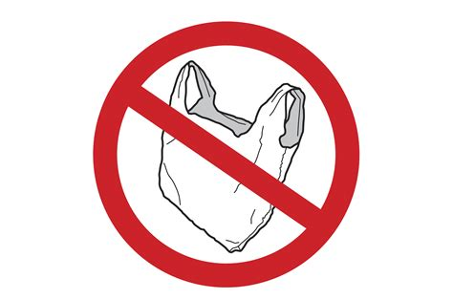
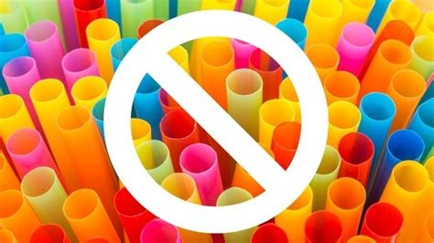
Government action: banning plastic
Malena
Example: UK
Plastic straw
Plastic bags
Cotton swabs
The ban is a step toward the country's goals to eliminate avoidable plastic waste as part of the 25 Year Environmental Plan.
Source: https://www.forbes.com/sites/trevornace/2018/04/25/uk-to-ban-all-plastic-straws-q-tips-and-single-use-plastics/#466e50d71138

Slide 11
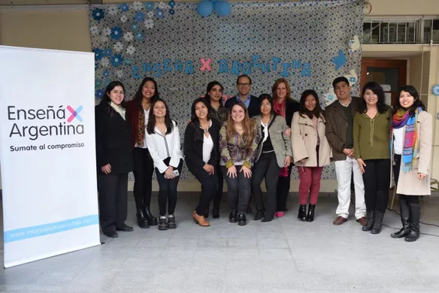
Regulations. Denise
¨Enseñá por Argentina¨ is a foundation that promotes young students and teachers to do collaborative work in order to learn. In the case of plastic pollution, some students proposed to go to a sector of the Paseo Costero of Vicente Lopez and they ended up going the 13th of may of 2018.
Reward people that help in the cleaning of beaches and picking up trash.
The government can give money for the people that collaborate with the picking up plastics in the beach or public places such as parks.
If people pick up the trash they see on the floor, the government can have a place where to throw this things and the people that helped can be rewarded with either money or benefits.
School could go and clean places with trash such as the río de la plata.

Slide 12
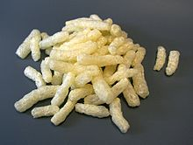
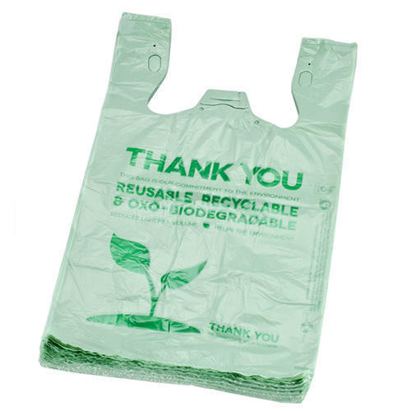
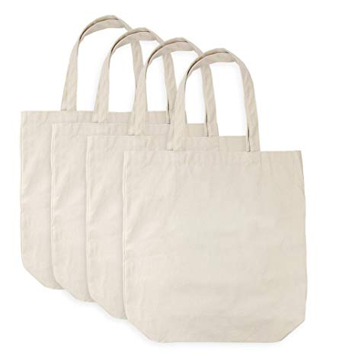
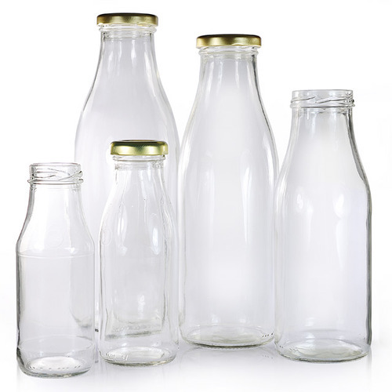
Alternatives to plastic
Sofìa S
Starch-based Polyesters
low cost
biodegradable
Biodegradable plastics
PLA Polyesters
PHA Polyesters
PCL Polyesters
all of them degrade after 6 weeks
high cost
plastic additives (addition of PDC’s)
PDC’s break down the plastic
slowly desintegrate
cloth bags (paper)
glass
isn’t made from fossil fuels
made from renewable resources
no chemicals
easily recycled
https://science.howstuffworks.com/environmental/green-tech/sustainable/5-plastic-substitutes10.htm

Slide 13
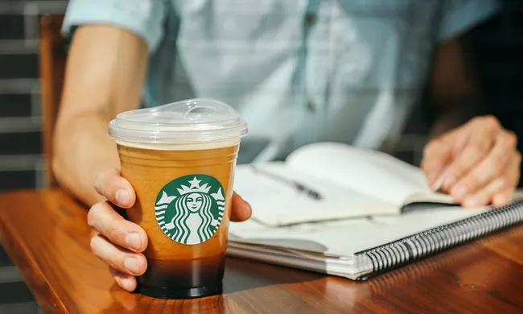
Starbucks will stop using disposable plastic straws by 2020, eliminating more than one billion straws a year.
Instead, they will use recyclable, strawless lids on most of its iced drinks. The Frappuccino is the one exception: It will have a straw made from either paper or compostable plastic.
https://www.nytimes.com/2018/07/09/business/starbucks-plastic-straws.html

Slide 14
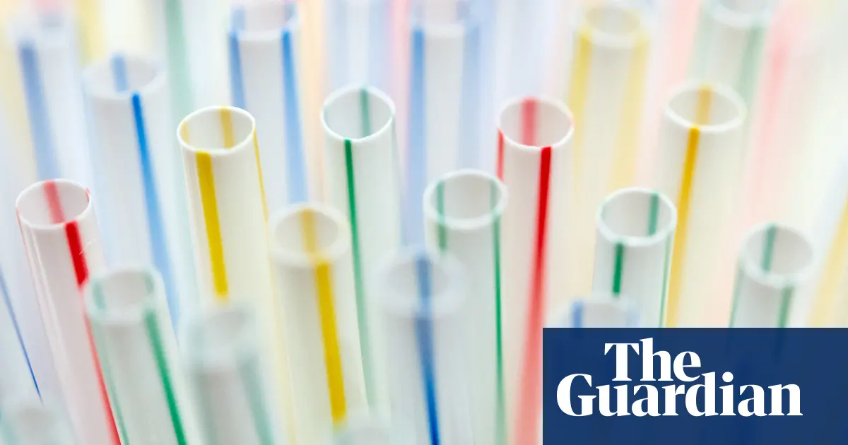
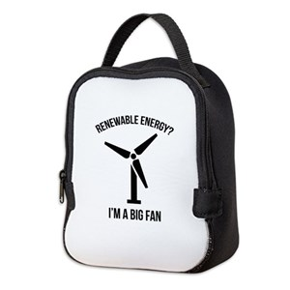
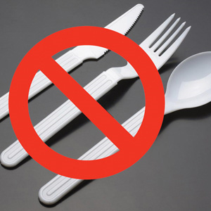
How to reduce plastics in:
Schools:
Pack your lunch in reusable containers and bags
Bring a reusable bottle to drink water
Don’t bring chewing gum
Don’t use plastic utensils even if the school provides them
Make teachers teach students more in depth about the negatives of plastic pollution
Make a “competition” and the people who use the least amounts of plastic per week get rewarded

Slide 15
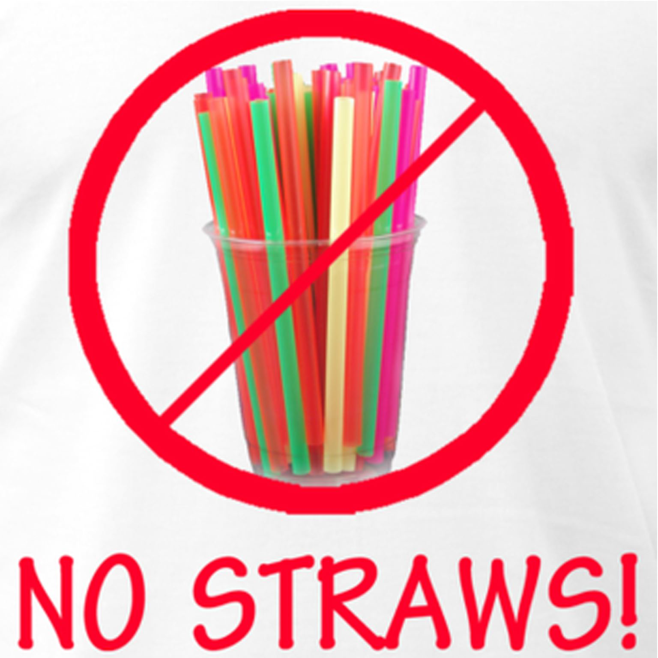
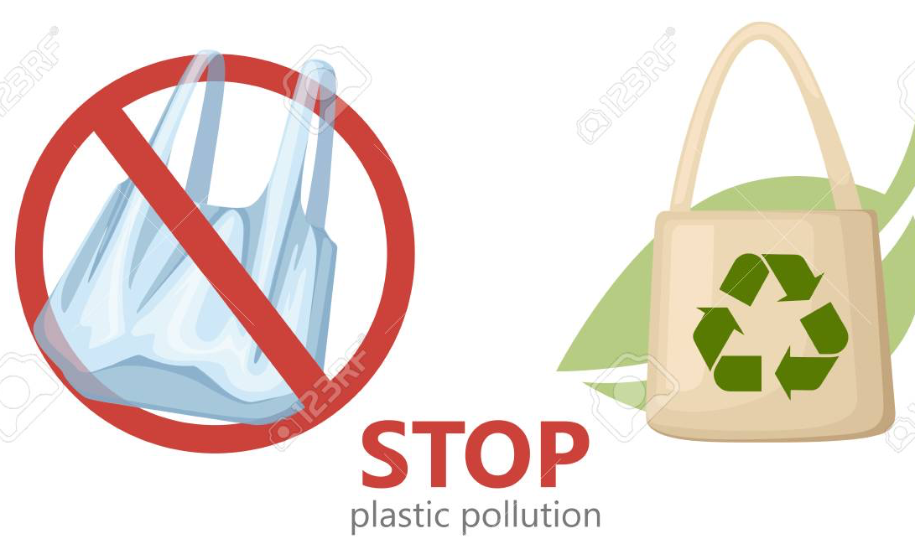
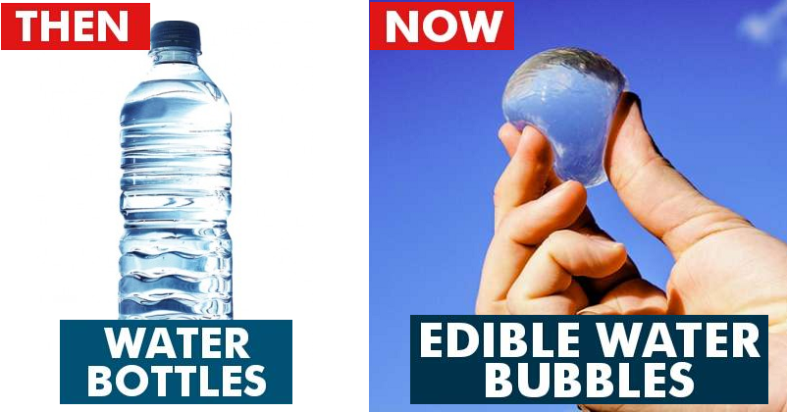
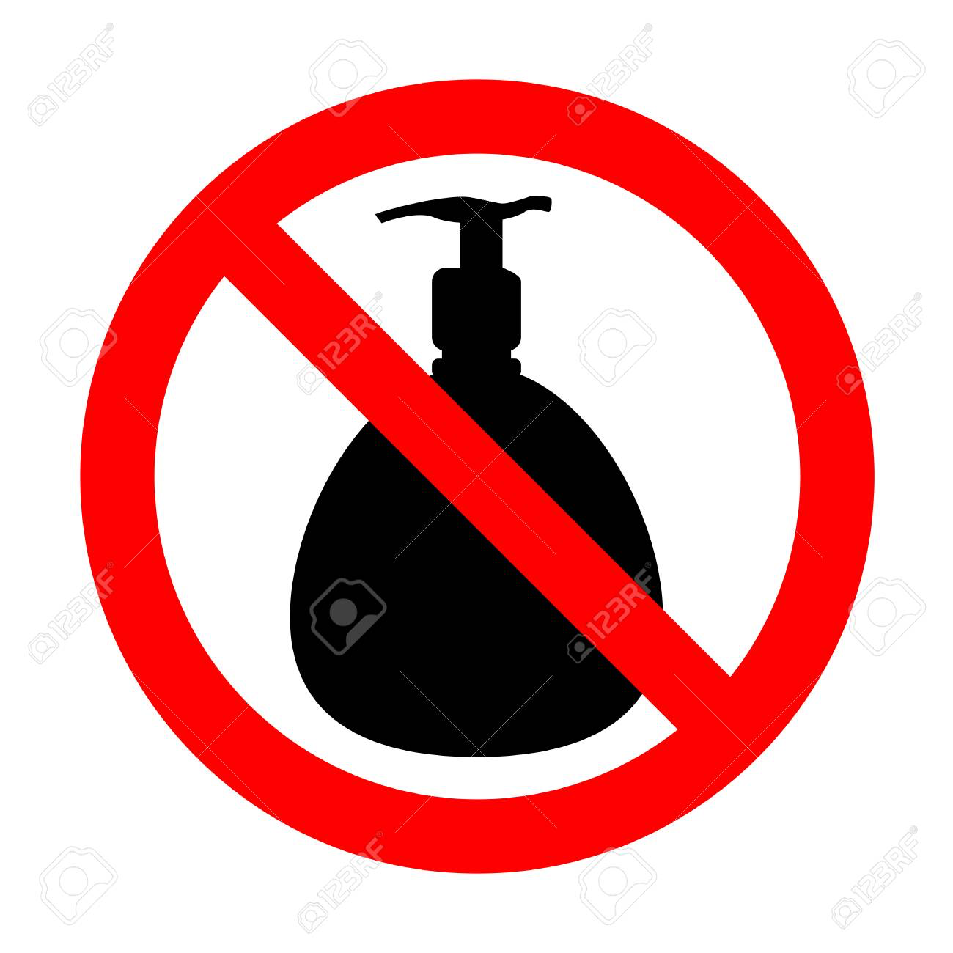
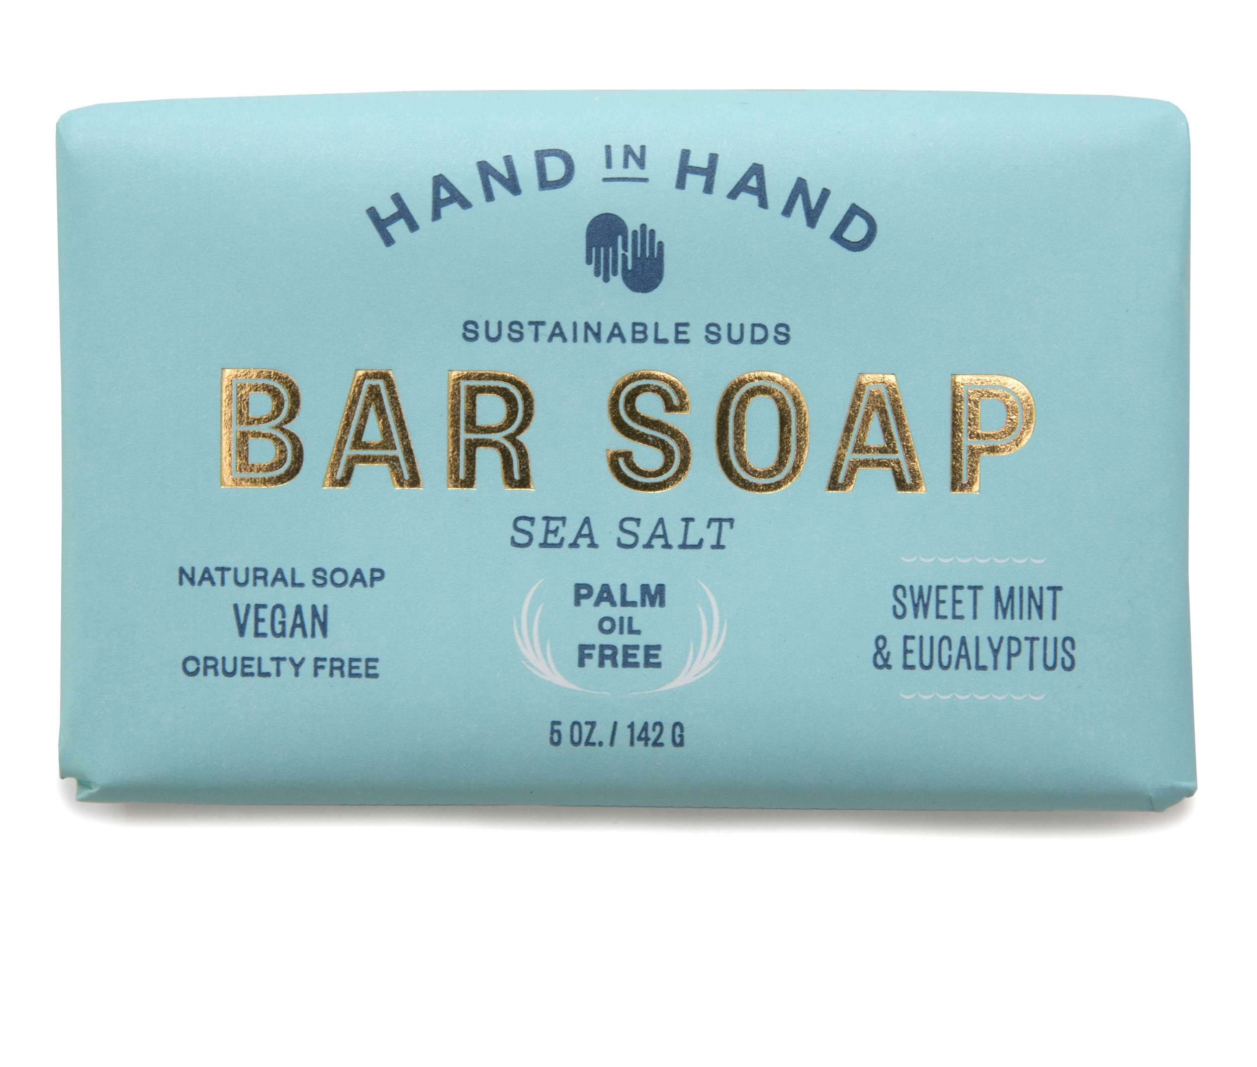
Reducing plastics in:
Tomas.f
Houses:
Avoid plastic water bottles.
Bring a reusable grocery bag.
Skip the plastic straws.
Make your own food whenever possible
Buy bar soap instead of body wash

Slide 16
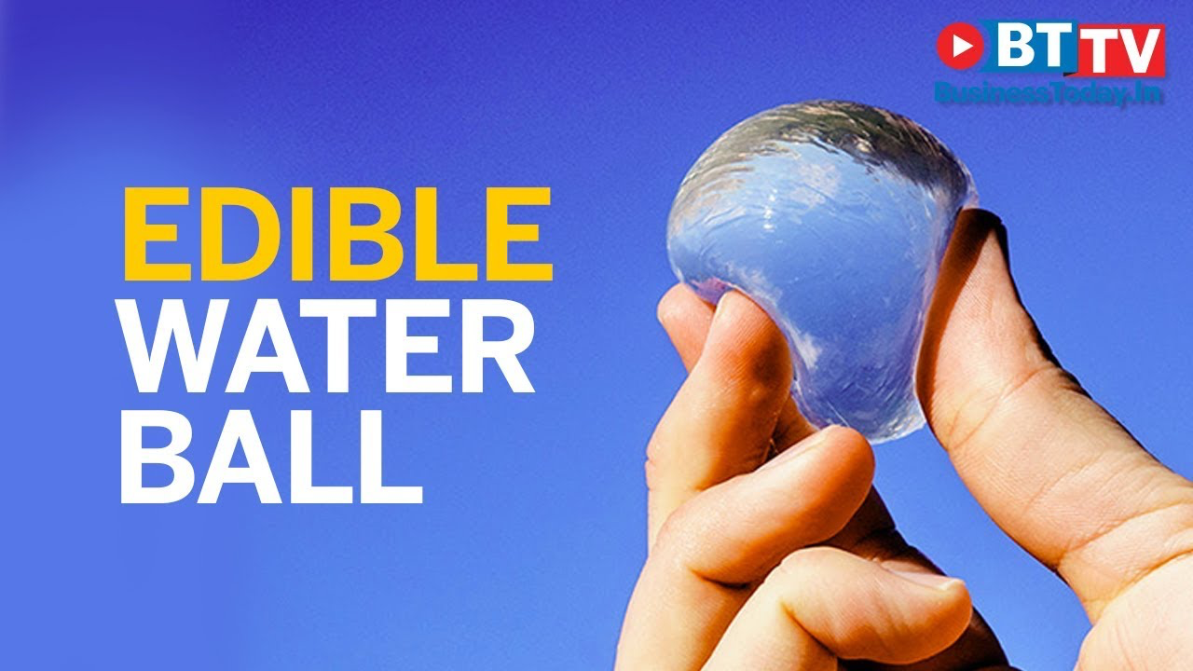
Tomas.f
How to reduce plastics at home:
Edible water balls:
https://www.youtube.com/watch?v=KppS7LRbybw

Slide 17
CLEAN UP AND RESTORATION

Slide 18
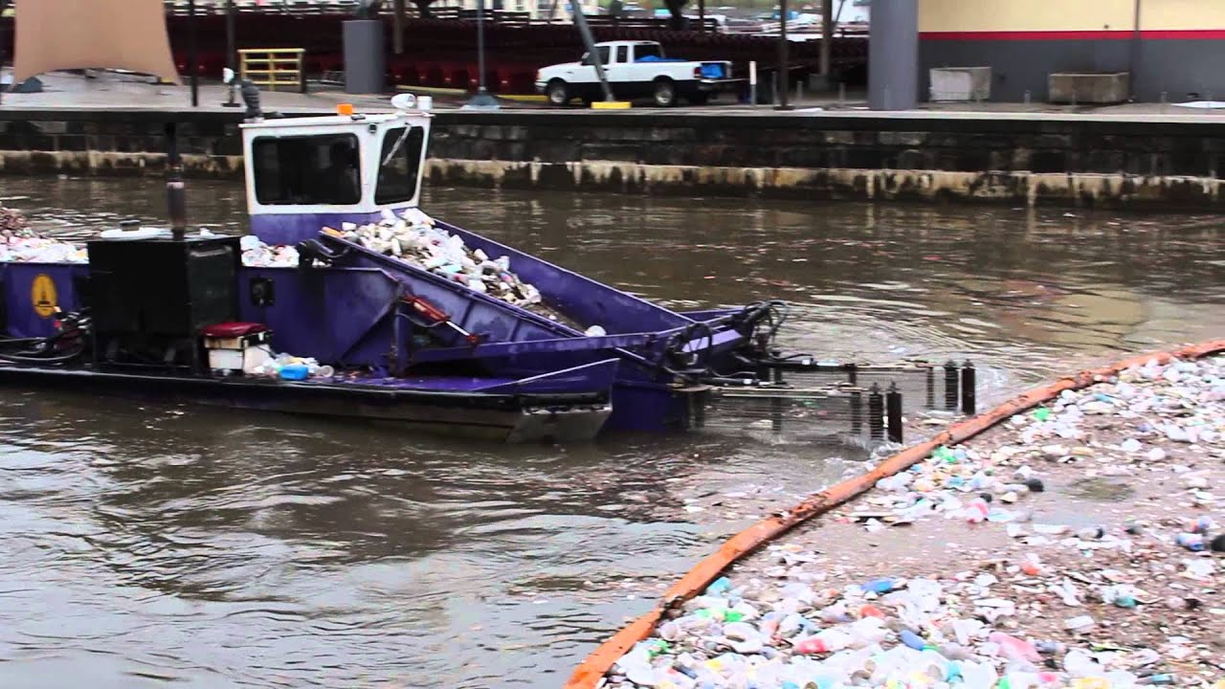
skimmers
Obregón
In order to clean the ocean pollution, they created the skimmers
Gadget in the water to clean plastic pollution in the ocean/sea
Skimmers generally effective ONLY in calm waters
First and biggest clean up system was in San Francisco, Removing Plastic Pollution from the Great Pacific Garbage Patch
OVER 5 TRILLION PIECES OF PLASTIC CURRENTLY LITTER THE OCEAN

Slide 19
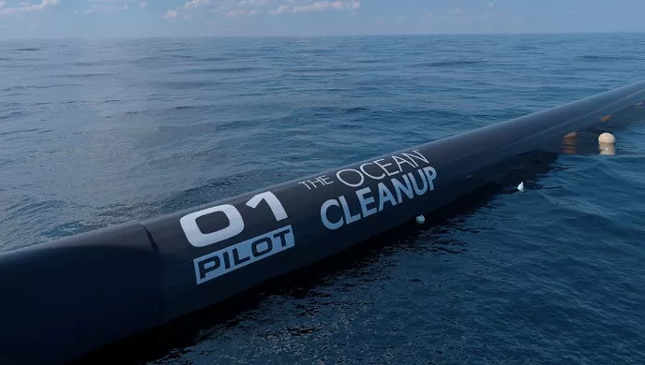
San Francisco Clean up (System 001)
Obregón
The system consists of a 600-meter-long floater that sits at the surface of the water and a tapered 3-meter-deep skirt attached below. The floater provides buoyancy to the system and prevents plastic from flowing over it, while the skirt stops debris from escaping underneath.
Could clean up 50% of the Great Pacific Garbage Patch in 5 years.
Combining the cleanup with source reduction on land paves the road towards a plastic free ocean by 2050.
https://www.theoceancleanup.com/system001/
https://www.theoceancleanup.com/

Slide 20
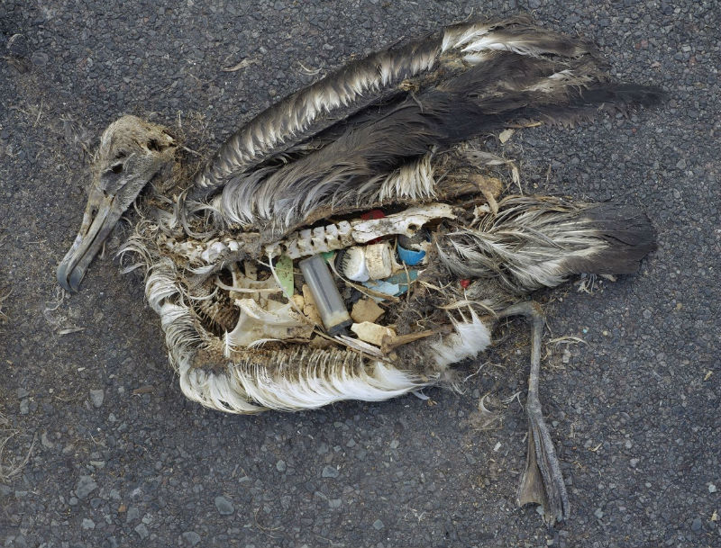

Slide 21
Local Spaces Cleaning
The Campaign consist in cleaning the public sectors:
Beaches
Peru Beach (San Isidro Coasts)
Palermo Streets
Hipódromo de San Isidro Park
Olivos Coasts
How to set a day + Where?
Payments for materials:
Mercado libre
Gloves: $80
Bags: $15 each (2 per person apox.)
Garbage pickers (Natural sticks can be used as well): $200
Total = $320 > Approximate
Whatsapp groups: Invite link
Organize the time and distribute the spaces where the cleaning is going to be carried out
Instagram page: Lead to the Whatsapp invite link
Can be reduce with donations

Slide 22
Date + Time
Campaign Name: "It's Time to Clean Up"
Contact number

Slide 23
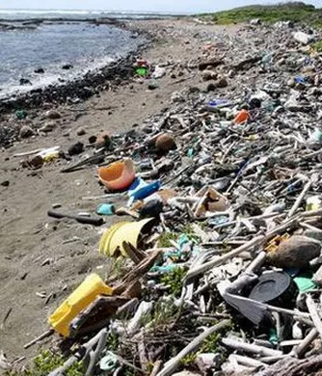
Cleaning local beaches
Make it a charity work.
Collect garbage in groups of people.
Make prisoners collect garbage from the beach as charity work.
This would improve the visual aspect of the beach as well as the odor and the contamination of the water.

Slide 24
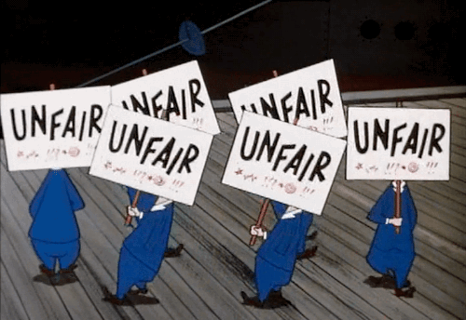
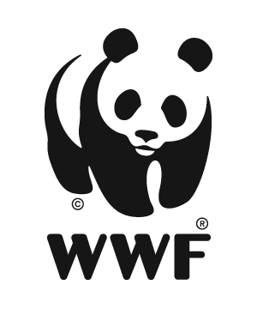
Why protest?
https://youtu.be/KUpMG9EPvjg
protest: important role. Ability for ordinary citizens to make their disapproval heard.
This type of activism is crucial for creating the groundwork for change.
IT CREATES CONSCIOUSNESS

Slide 25
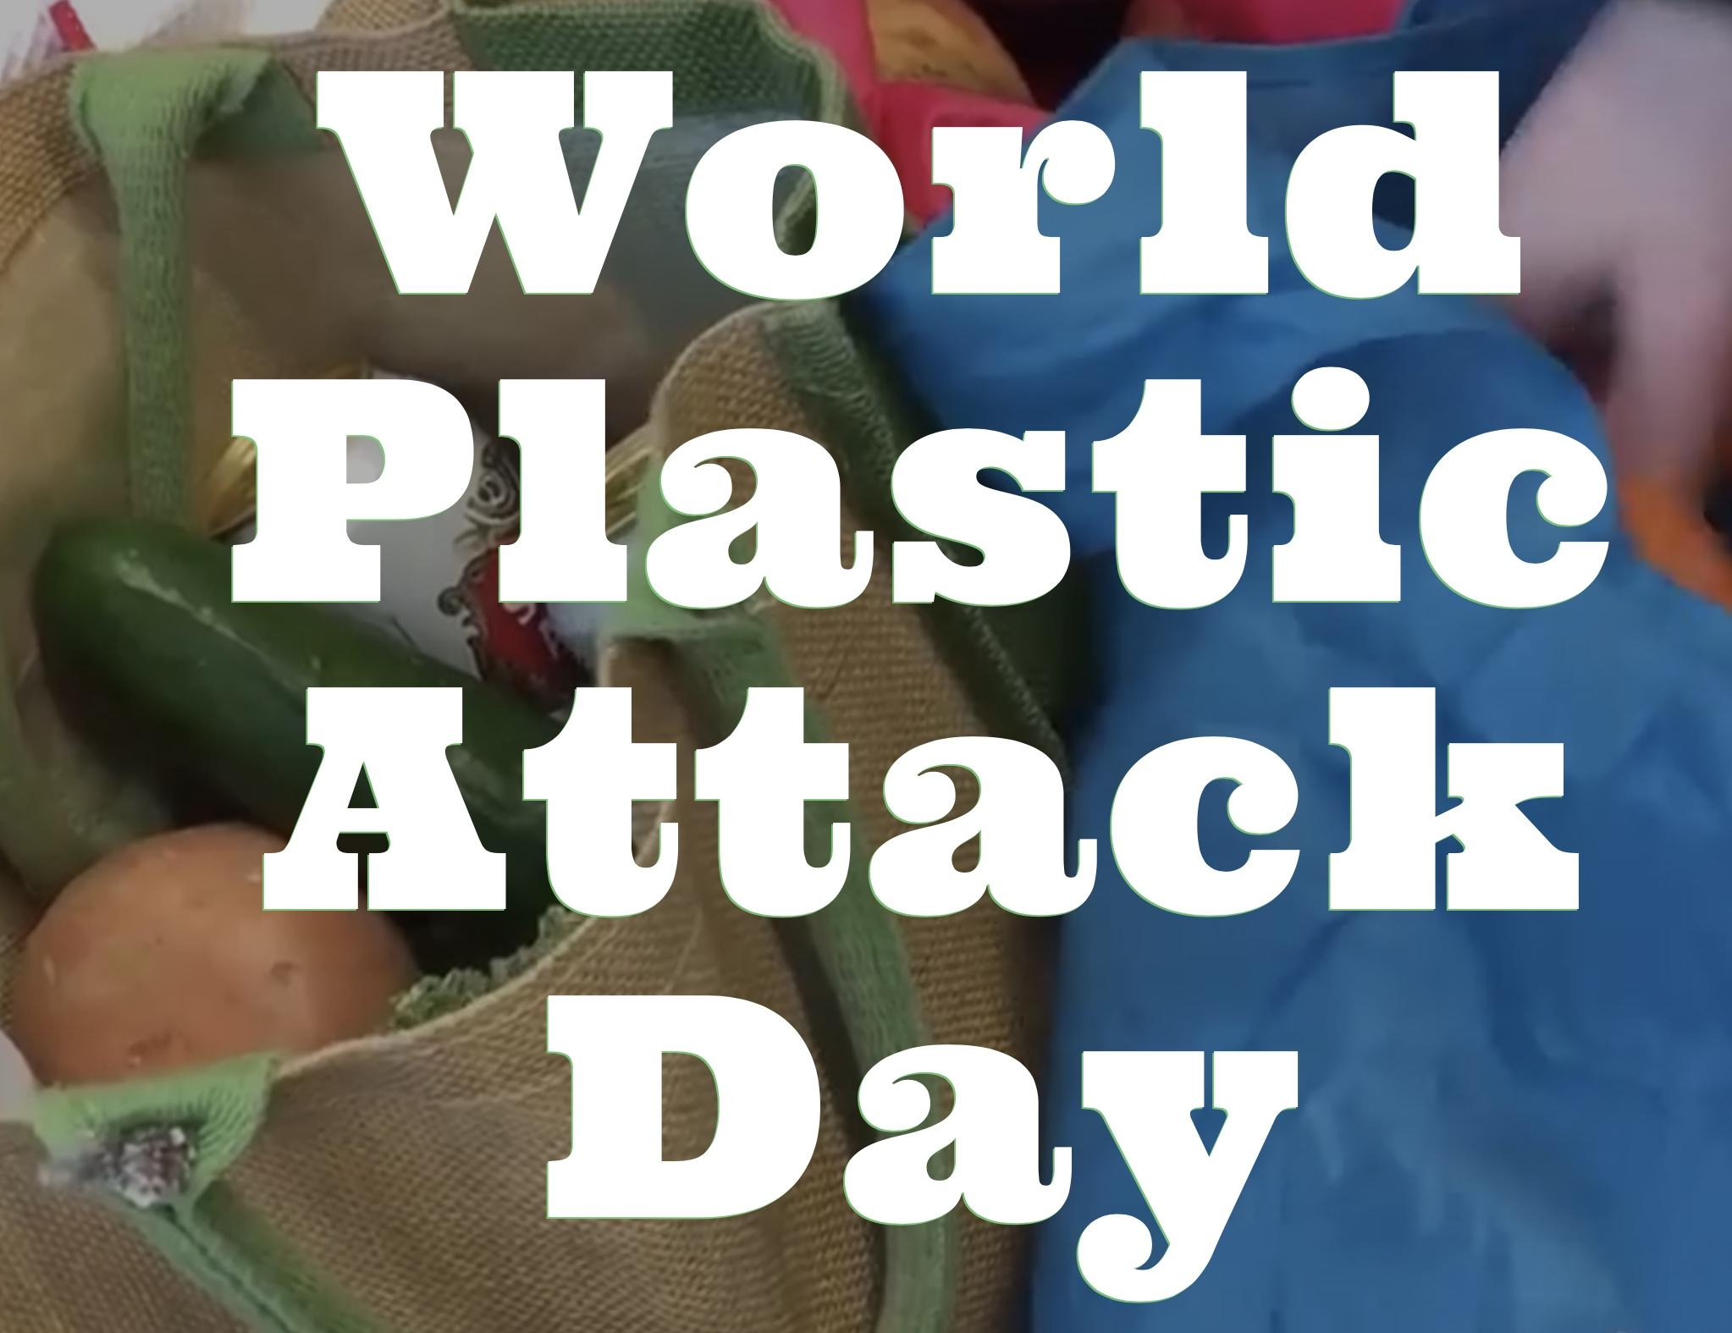
Mar
https://youtu.be/Dm1Cb7sPviI
https://plasticattack.co.uk
When? 15/09/18
Where? WORLDWIDE
->supermarkets and shops
“Plastic Attacks are now spreading across the world but it all started in the small English town of Keynsham near Bristol. A small group of shoppers decided they had had enough of excessive amounts of plastic packaging. Their idea was simple, 'just leave it all behind!'”

Slide 26
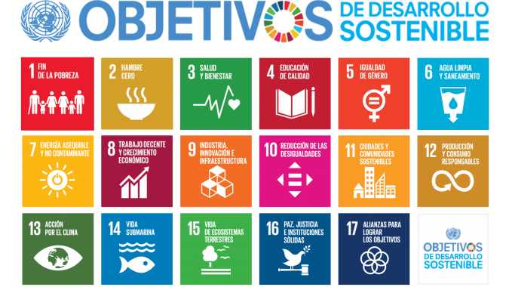

Slide 27
Bibliography:
https://en.wikipedia.org/wiki/PET_bottle_recycling
http://hwestequipment.com/8-things-made-recycled-plastic/
https://www.treehugger.com/green-home/11-easy-ways-reduce-your-plastic-waste-today.html

