Slide 1
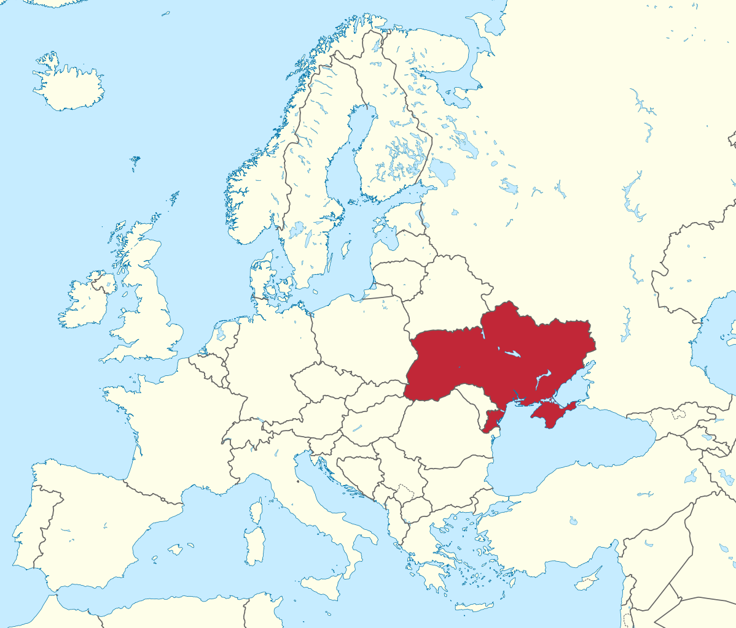
Ukraine

Slide 2
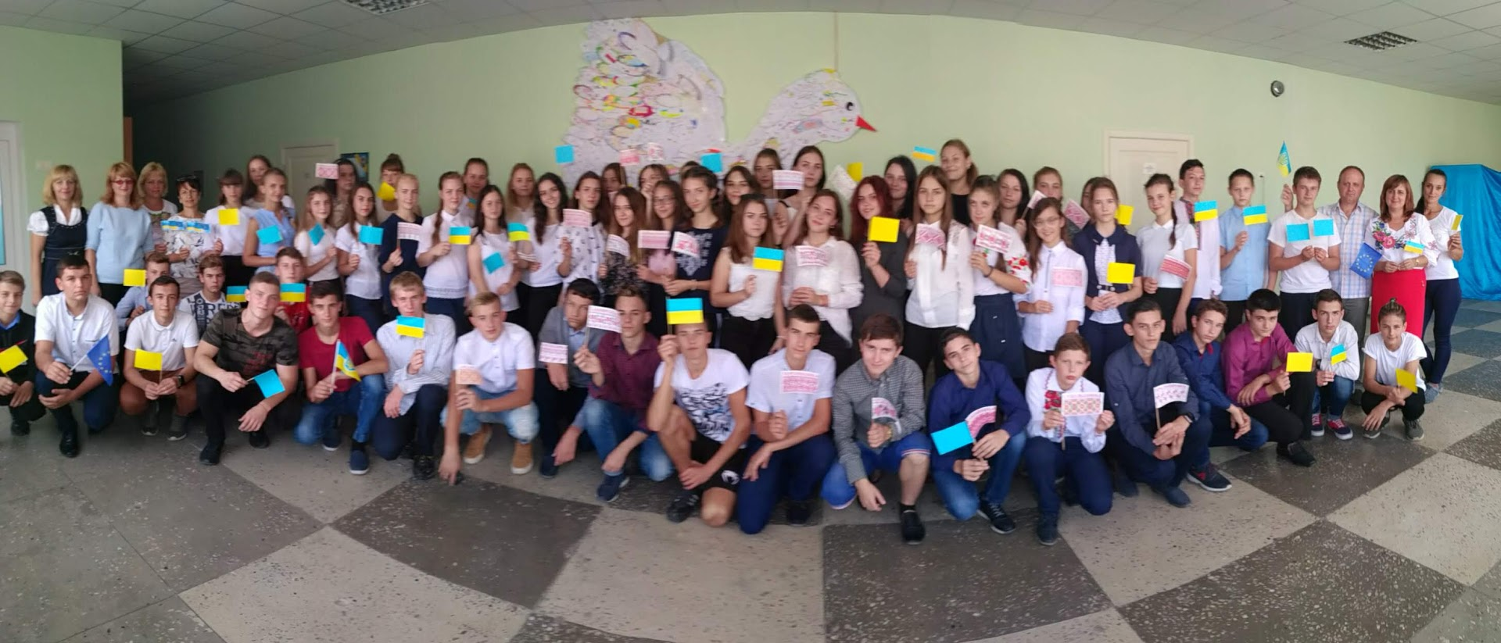
Horodyshche economic lyceum

Slide 3
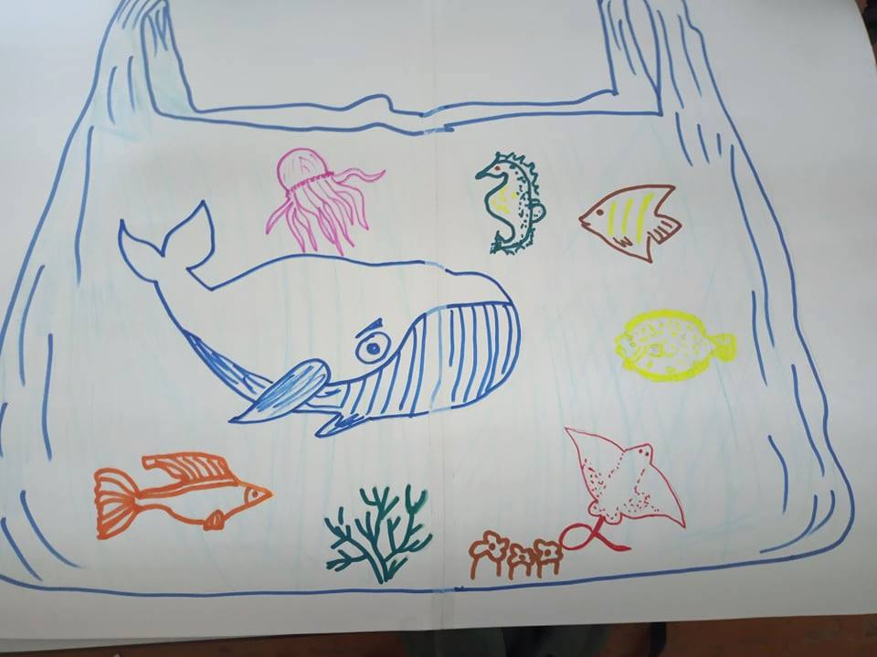
We are participants of
“No. More. Plastic.”project project

Slide 4
Amount of participants: Teachers – 2 Students – 80

Slide 5
Teachers who are responsible Shastun Victorya Marchenko Oksana

Slide 6
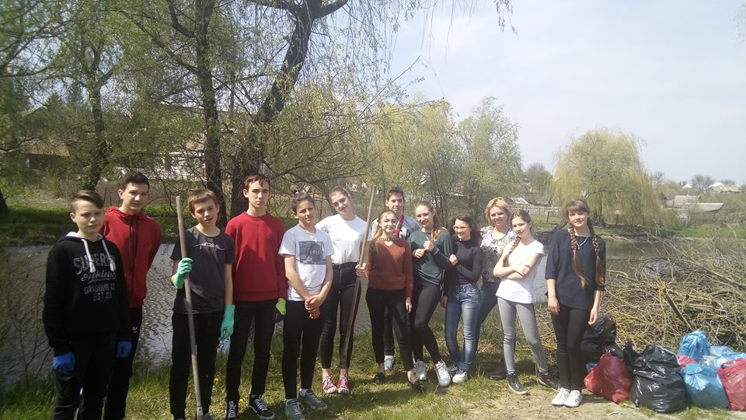
* Cleaning the places around our river Vilshanka * One student recorded a video appealing to local citizens to be eco-friendly.

Slide 7
Cleaning the places around our local river Vilshanka and announcing main ideas of the project

Slide 8
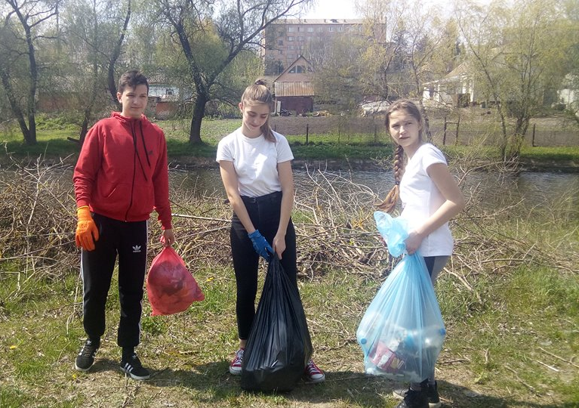
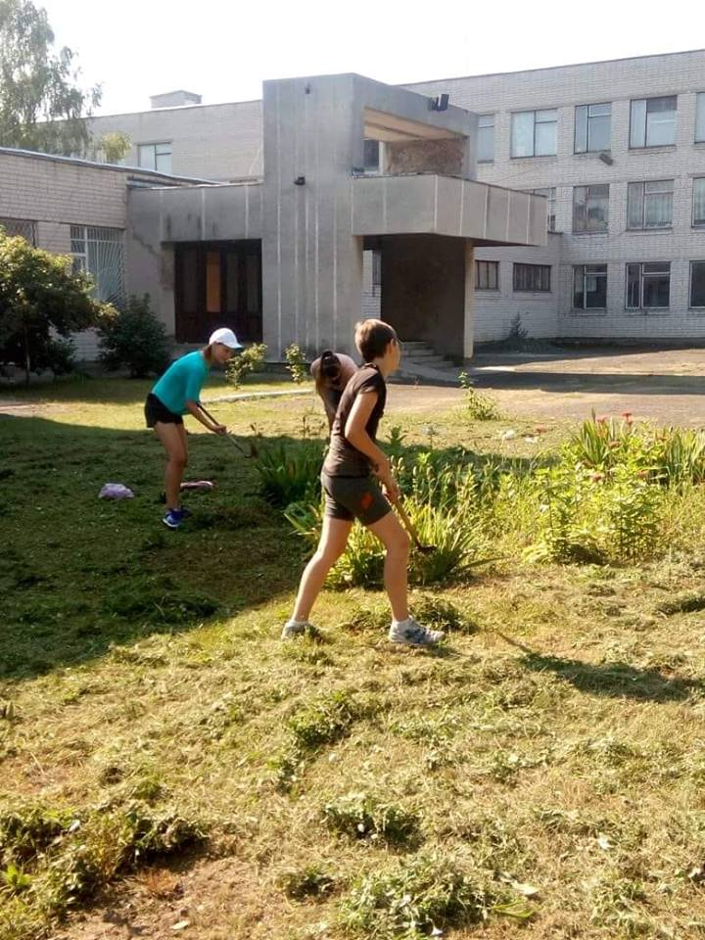
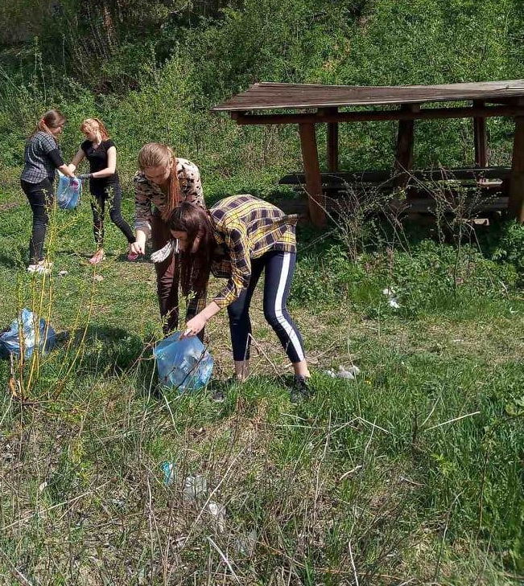

Slide 9
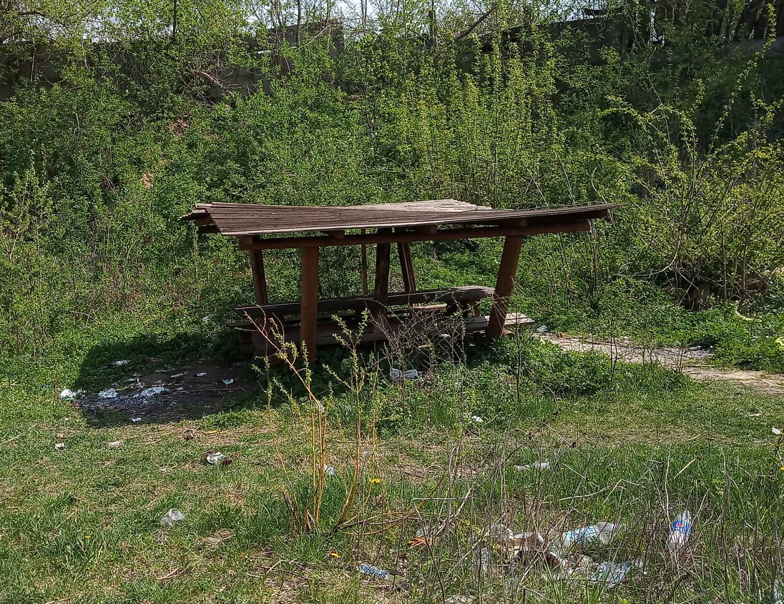
We cleaned this place and made it better before after

Slide 10
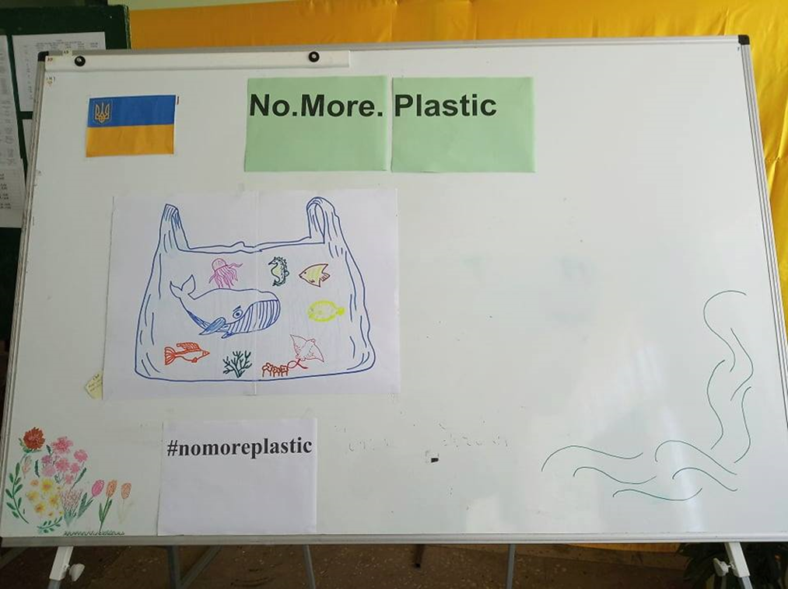
Making a poster

Slide 11
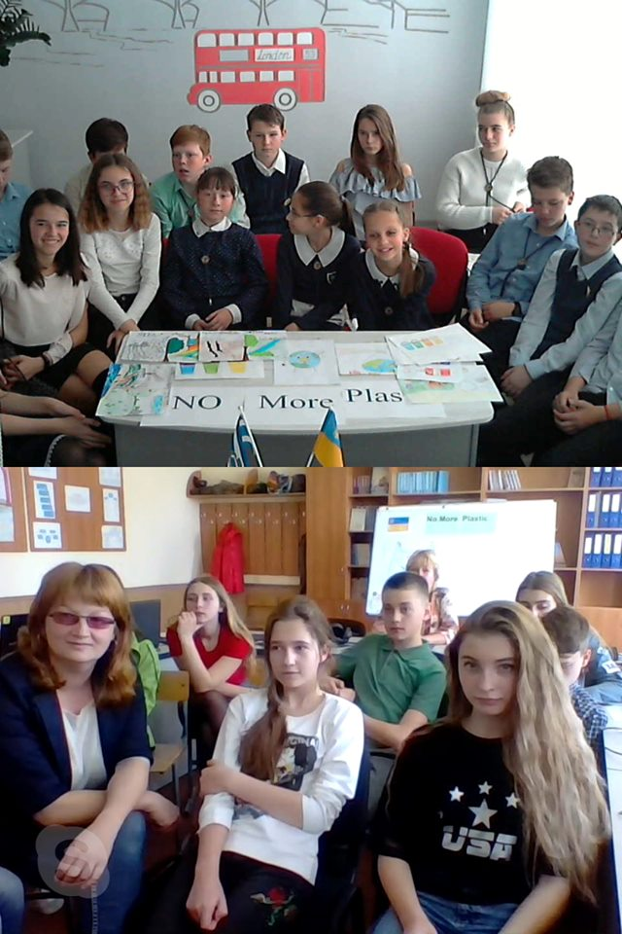
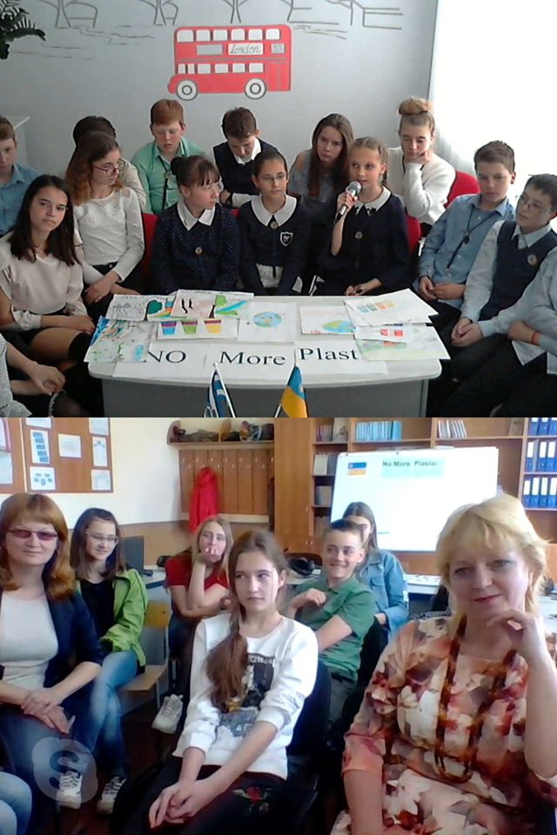
Skype meeting with Kherson gymnasium № 1

Slide 12
