Slide 1
Let’s Say No to Single Use Plastics
Adopt the 5 R’s Mantra;
Refuse
Reduce
Reuse
Recycle
Refine/Rethink

Slide 2
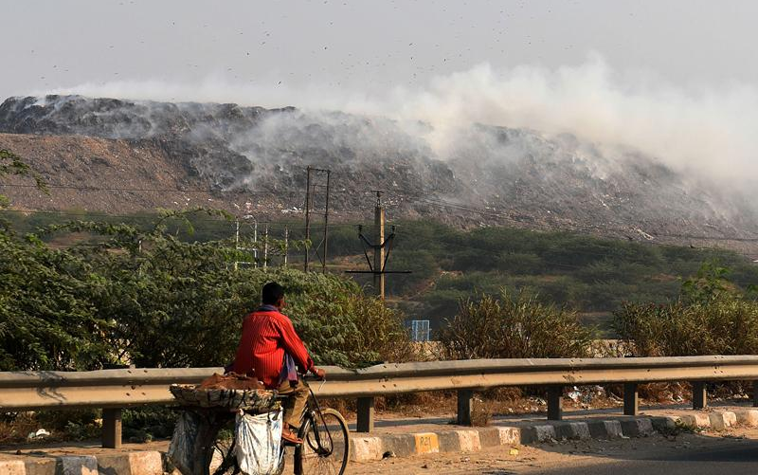
Do we need more of these?

Slide 3
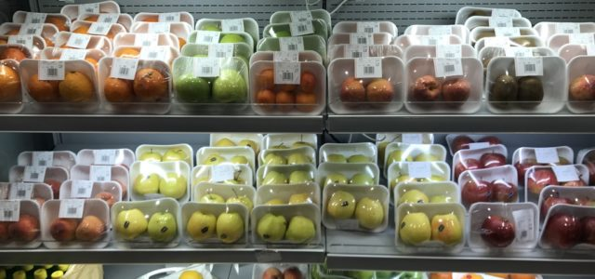
Why is it happening?
CONVENIENCE > SUSTAINABILITY
USE & THROW CULTURE
OUT OF SIGHT,OUT OF MIND

Slide 4
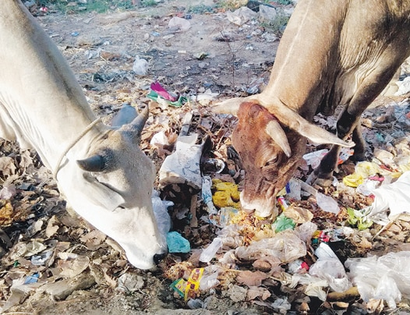
What's happening right now
Mixed waste
at local
dumps

Slide 5
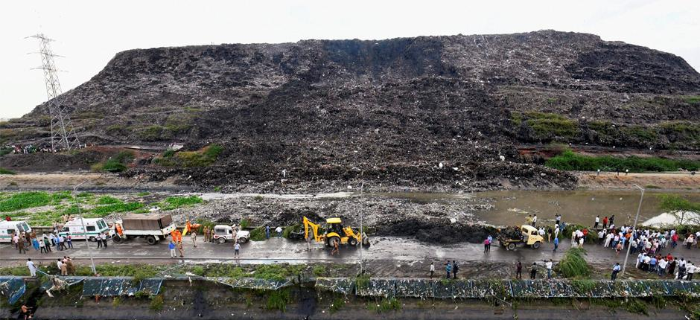
What's happening right now
Increasing burden on the landfills

Slide 6
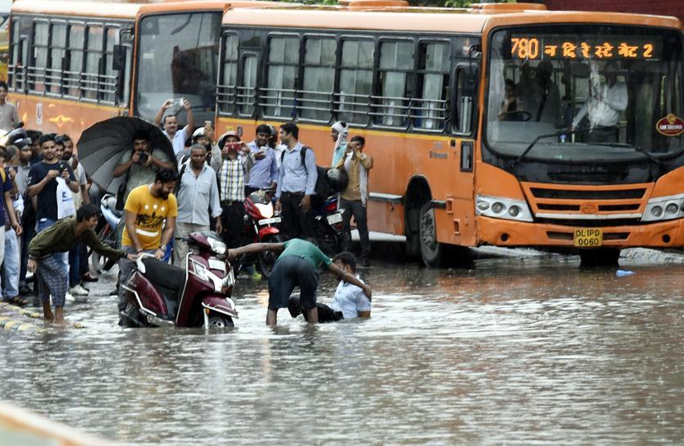
What's happening right now
Urban
flooding

Slide 7
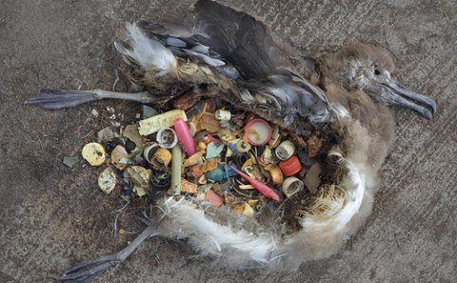
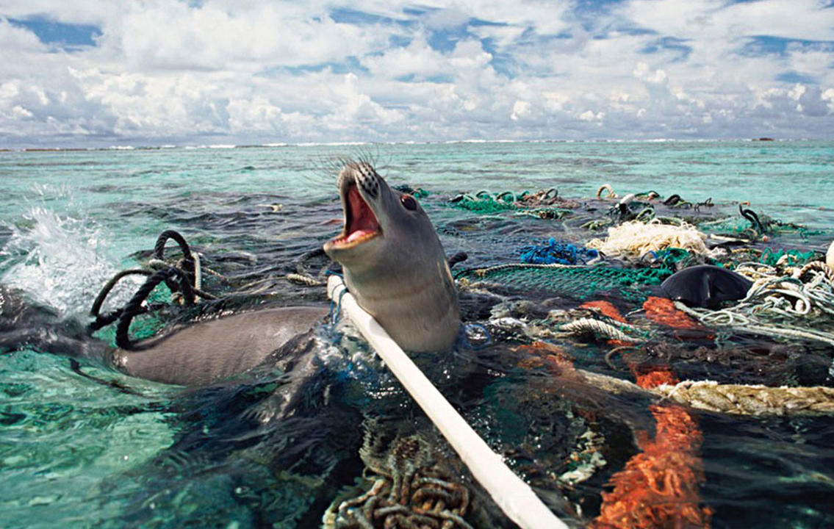
What's happening right now
Plastic in the
Ocean

Slide 8
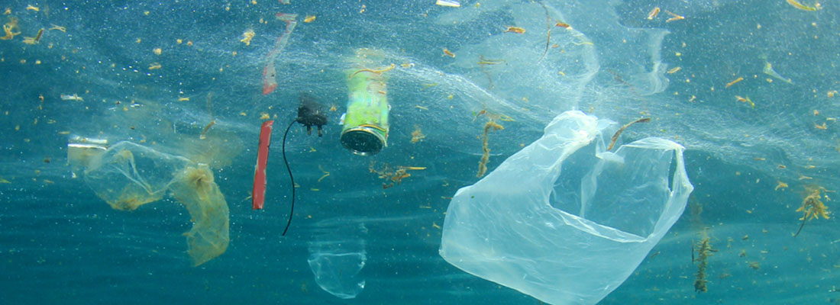
Plastic Soup
More and more plastic waste is ending up in our oceans and seas. Due to the effects of weathering, sunlight and wave action, this plastic reduces to smaller particles. This leads to serious pollution. The oceans occupy 72% of the earth’s surface and they are our principal source of oxygen. Plastic in ocean environments is deadly for many marine animals. Plastic does not degrade biologically.
As a result of the breakdown and fragmentation of plastic into smaller particles, ocean water has been transformed into a sort of global microplastic soup or Plastic Soup.

Slide 9
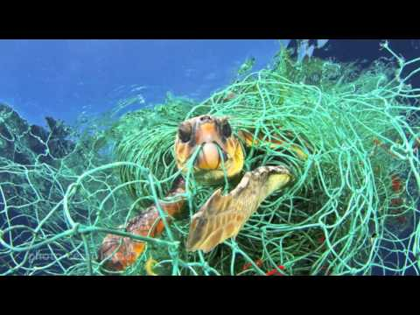
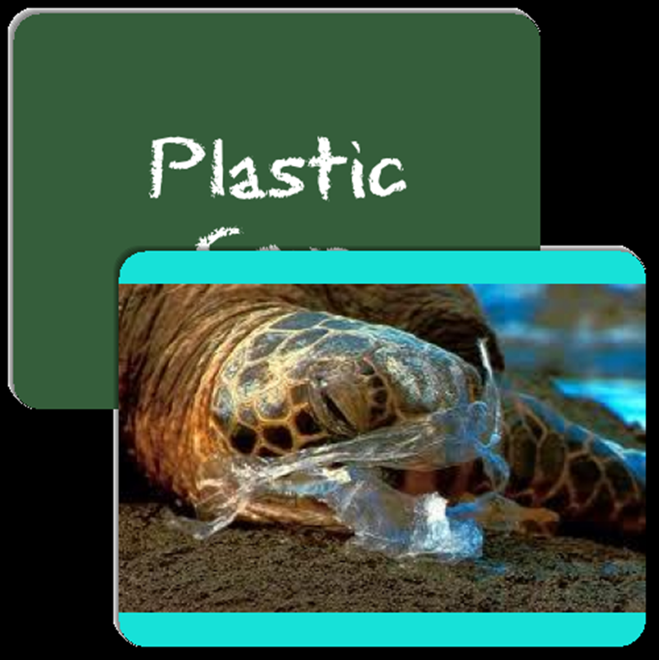

Slide 10
Let’s first take a look at few known facts on
PLASTICS
Made from fossil fuels
Plastic is a synthetic polymer.
Invented in 1885.
Malleable, lightweight,
transparent, unbreakable
BUT it is not BIODEGRADABLE.

Slide 11
Data that would make you think twice before using plastic
Every year, the world-
Produces 400 million tons of plastic.
Out of which at least 8 million tons of plastic
end up in the oceans.
Uses 500 million plastic bags.
In the last decade, we produced more plastic than in
the whole last century.
India alone consumed 17.8 million tons of plastic in 2017.

Slide 12
How many of you go to coffee houses/cafés?
How many of you ask them not to give a straw or the coffee cup lid?

Slide 13
How many of you order food online?
How many of you ask them not to give plastic forks and spoons?

Slide 14
How many of you go out to buy groceries and vegetables?
How many of you take your own cloth bags and refuse to take the plastic bags?

Slide 15
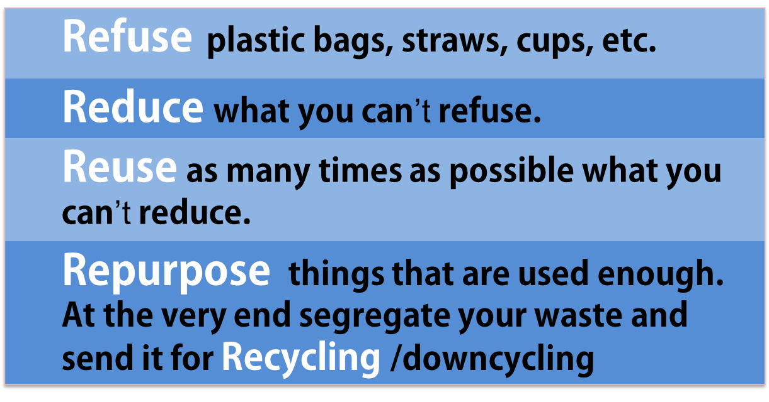
What can we do?

Slide 16
What do the rules say?
Source segregation mandatory
No open disposal, no burning
Process wet waste within the premises
Penalty on non-compliance

Slide 17
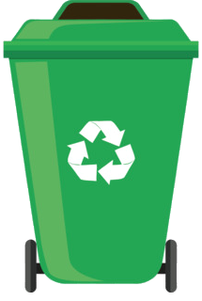
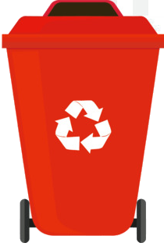
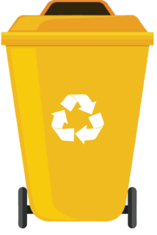
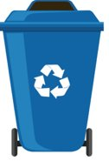
How to segregate?
WET
WASTE
SANITARY/ HAZARDOUS
WASTE
E-WASTE
RECYCLABLE/
DRY WASTE

Slide 18
How to segregate?
Wet Waste(51%)
Kitchen waste
Soiled paper/cardboard
Egg shells
Garden waste
Cooked food (less quantity)

Slide 19
How to segregate?
Sanitary/Hazardous
Waste (31%)
*Wrap in newspaper*
Diaper/sanitary napkins
Bandages/condoms/syringes
Medicines/medical waste
Razor blades/broken glass
Notes:
Last 15 days- 2 major fire incidents at two of the three landfills and this is the case every single year.
19

Slide 20
How to segregate?
E-Waste
Batteries
CFL/LED/tube lights
Wires
Electrical appliances
Flashlight/calculators/clocks

Slide 21
How to segregate?
Recyclable
Waste (18%)
Plastics (must be rinsed if soiled)
Paper/cardboard
Metals
Glass (unbroken)

Slide 22
How to dispose the waste?
Wet Waste
Wet waste should be processed within the premises (SWM rules)
Community composting in green belts/parks
Composting at household level
Biomethanation
Compost can be used in the parks

Slide 23
How to dispose the waste?
Sanitary/hazardous Waste
Carefully Wrap it in a newspaper
Handover to the waste picker separately
It will be incinerated or landfilled

Slide 24
How to dispose the waste?
Recyclable and E-Waste
Dry waste is further segregated and sent for recycling
E-Waste needs scientific and careful disposal

Slide 25
Thank You!

