Slide 1
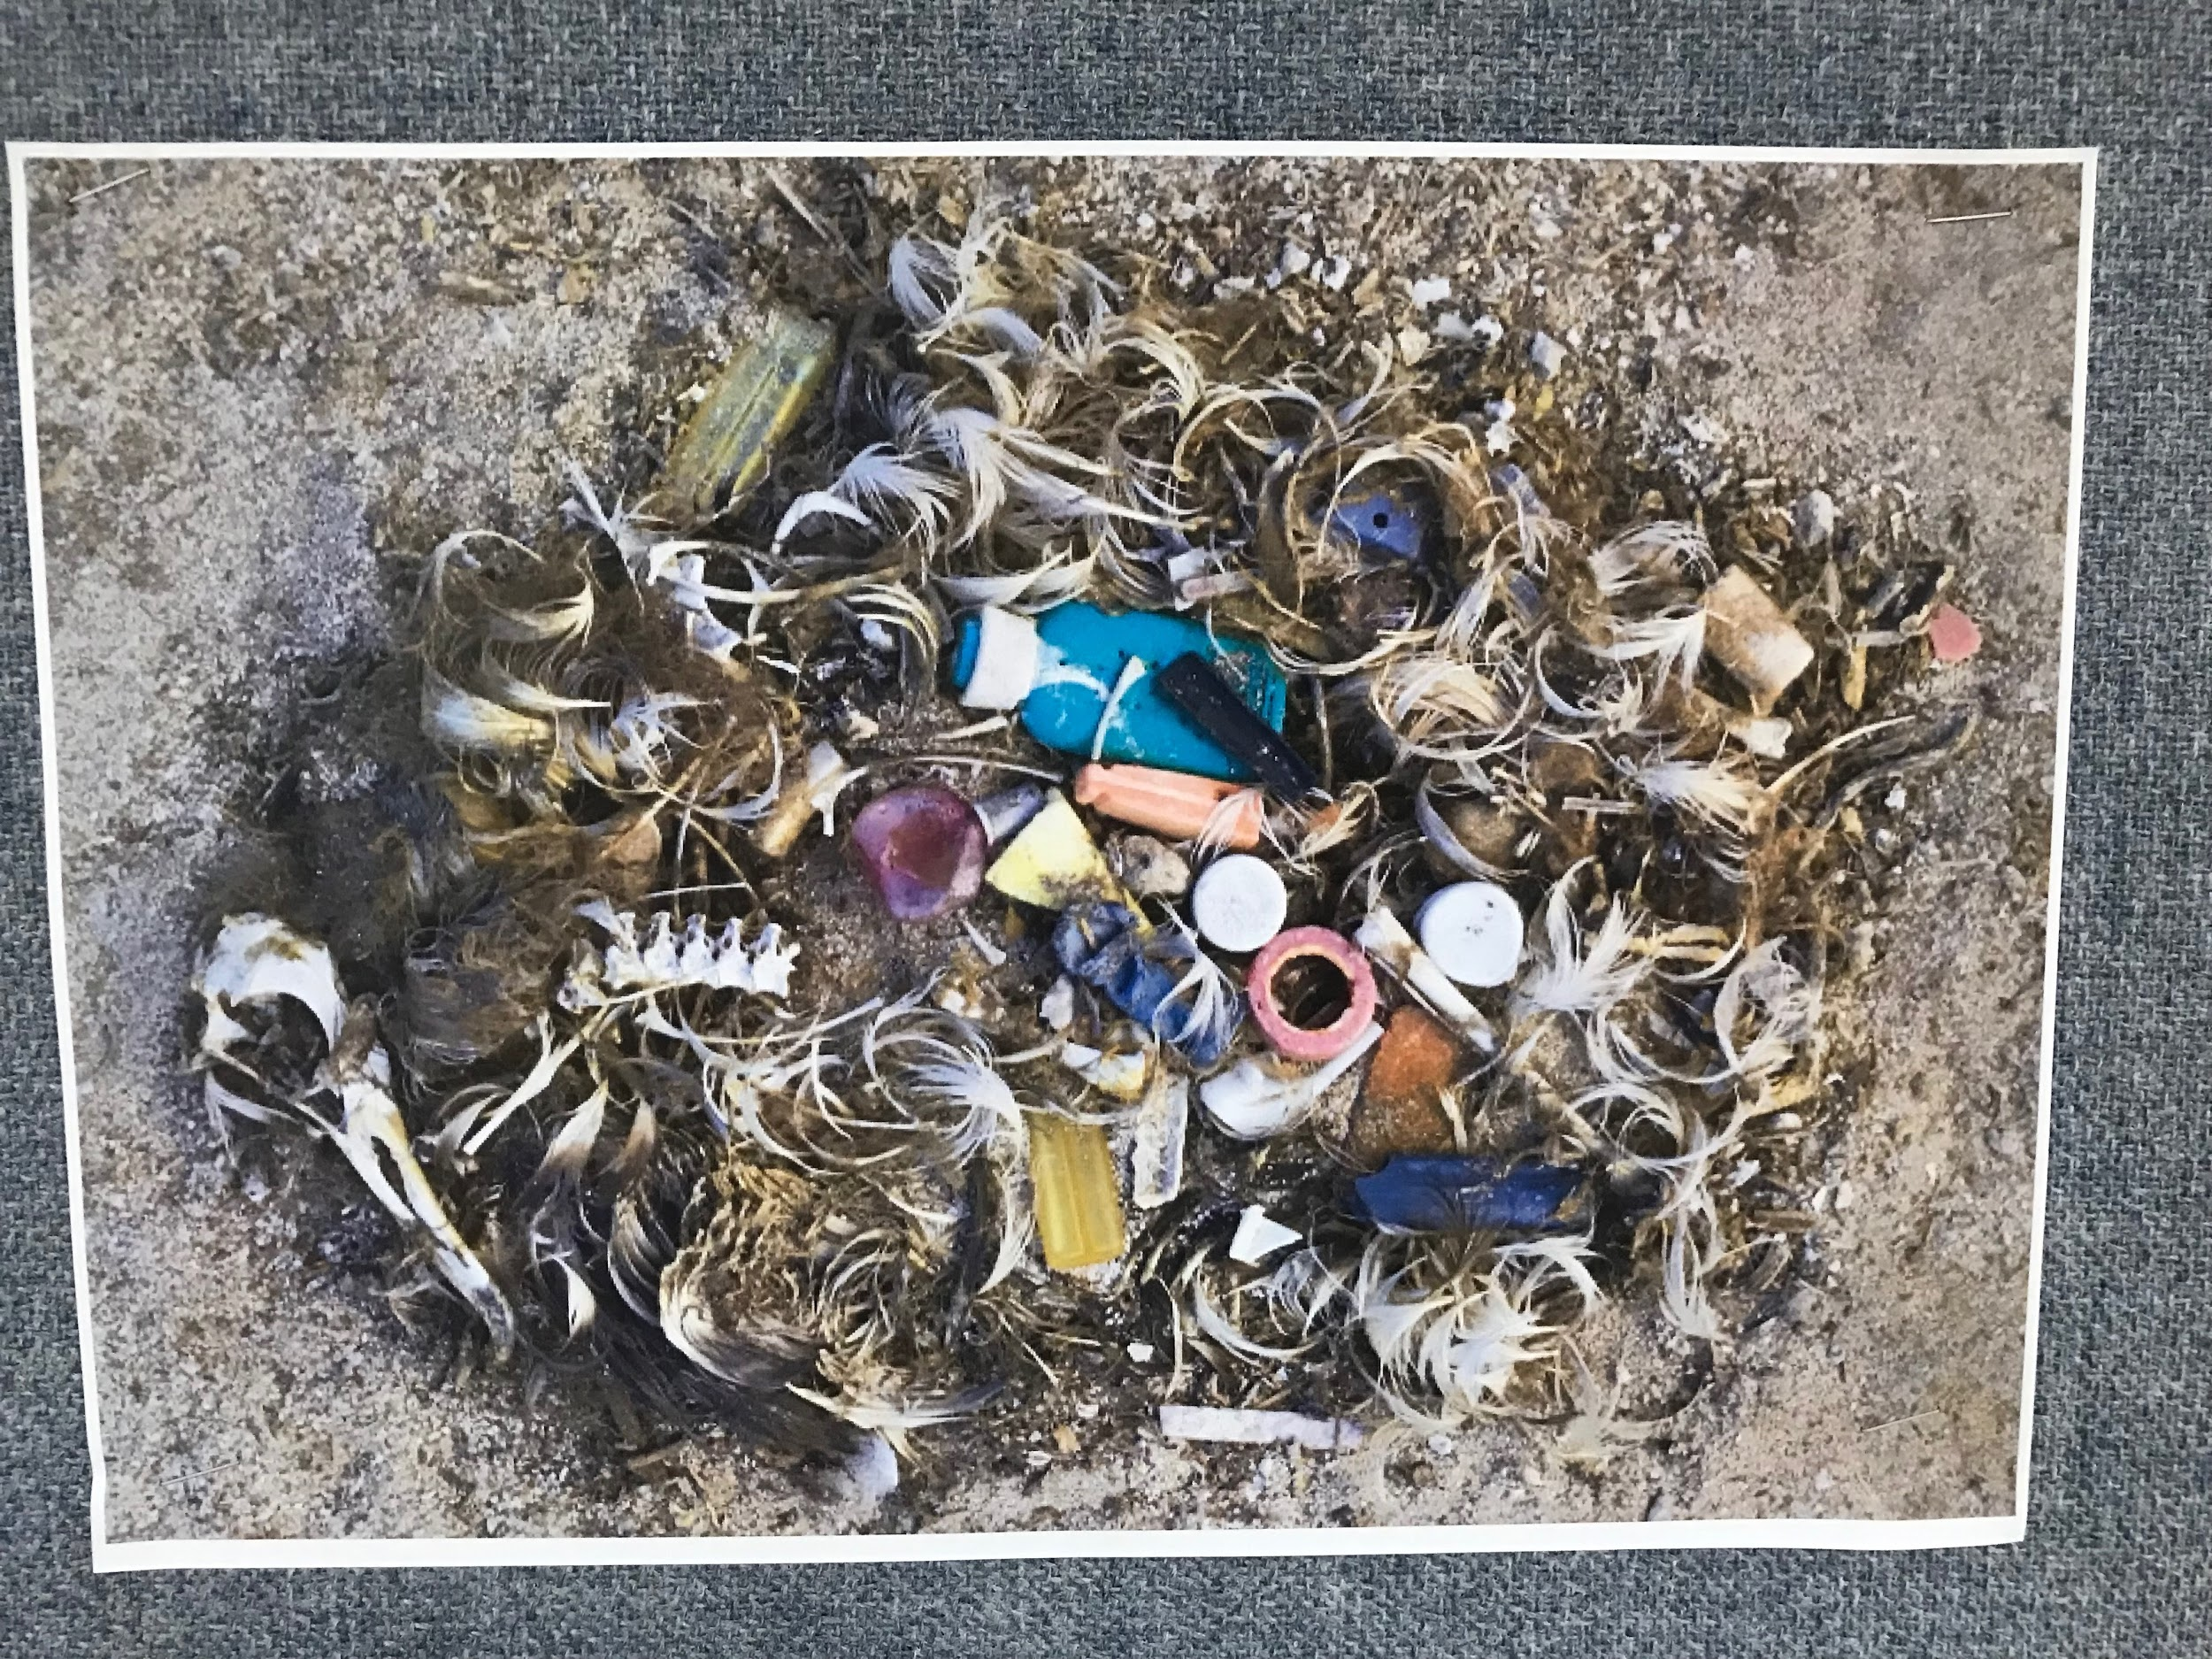
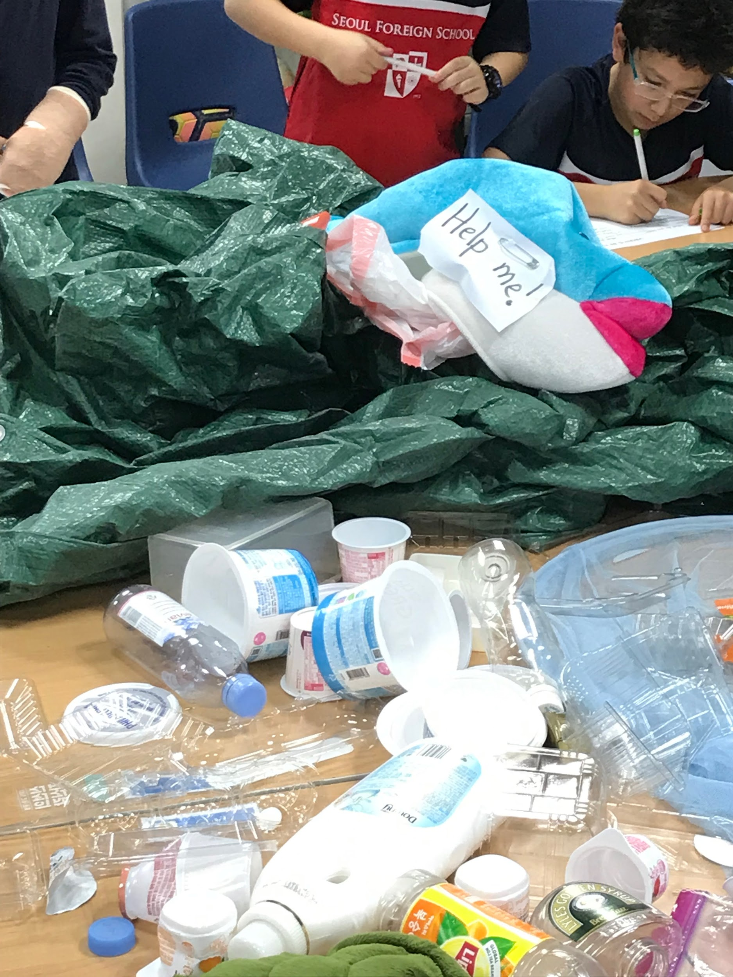
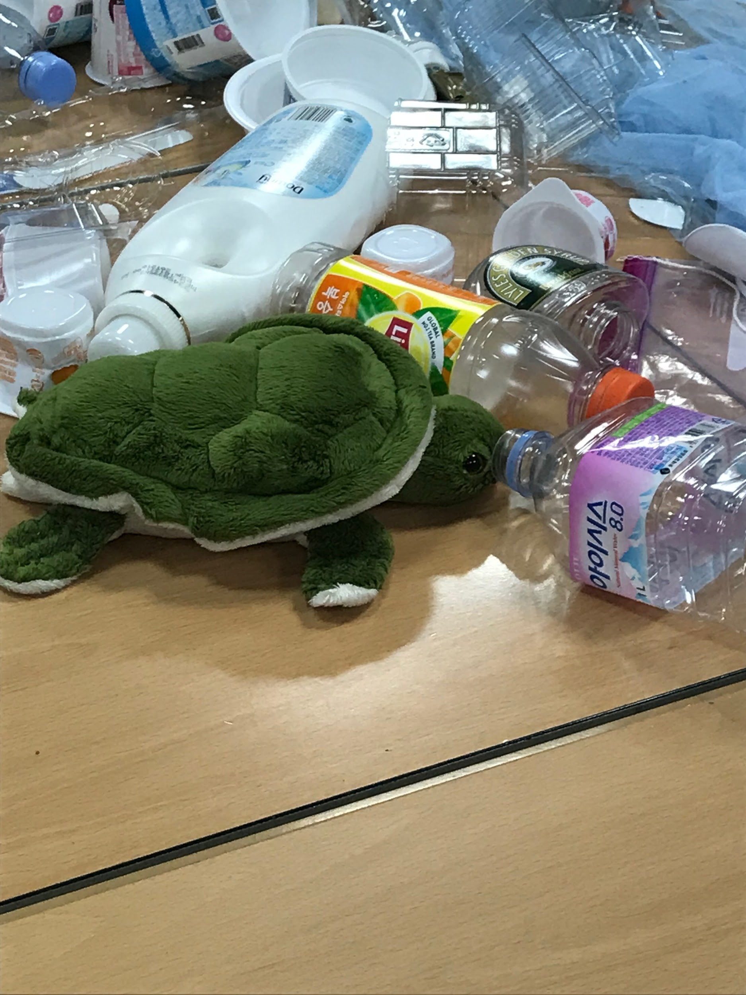
Seoul Foreign British School Year 4
We set up a ‘sea of plastic’ with pictures of animals that have been affected, along with a video, Ocean Pollution - Raising Awareness, in the classroom for the students to see, think and wonder about. https://www.youtube.com/watch?v=1qT-rOXB6NI

Slide 2
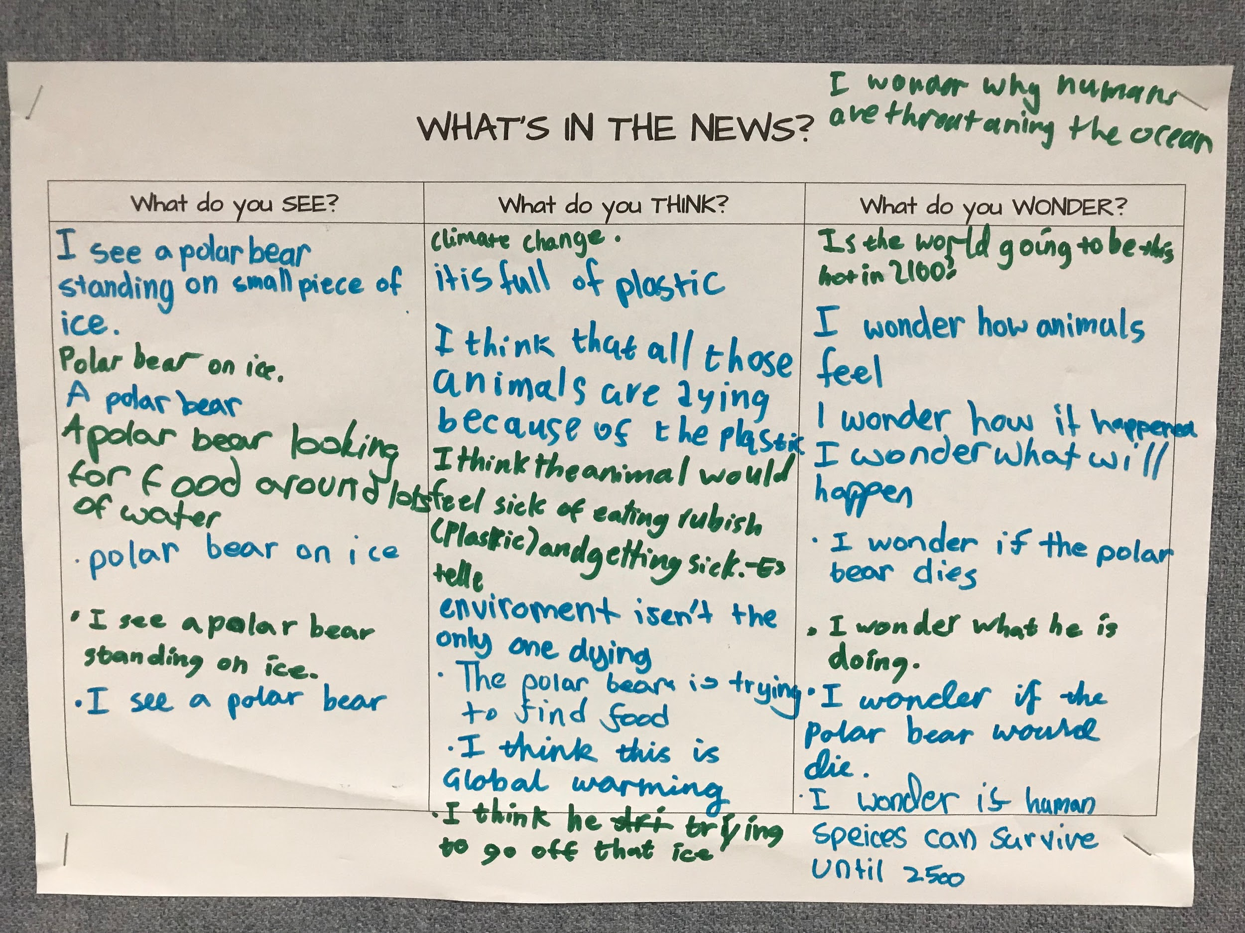
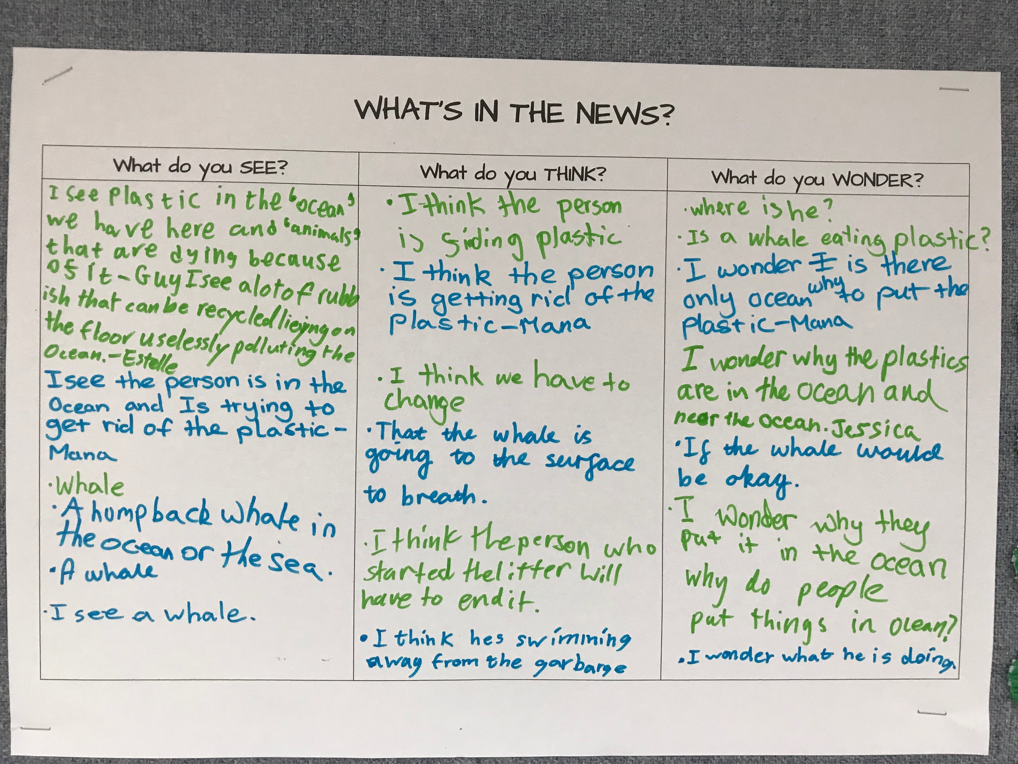
Here are some of the student responses...

Slide 3
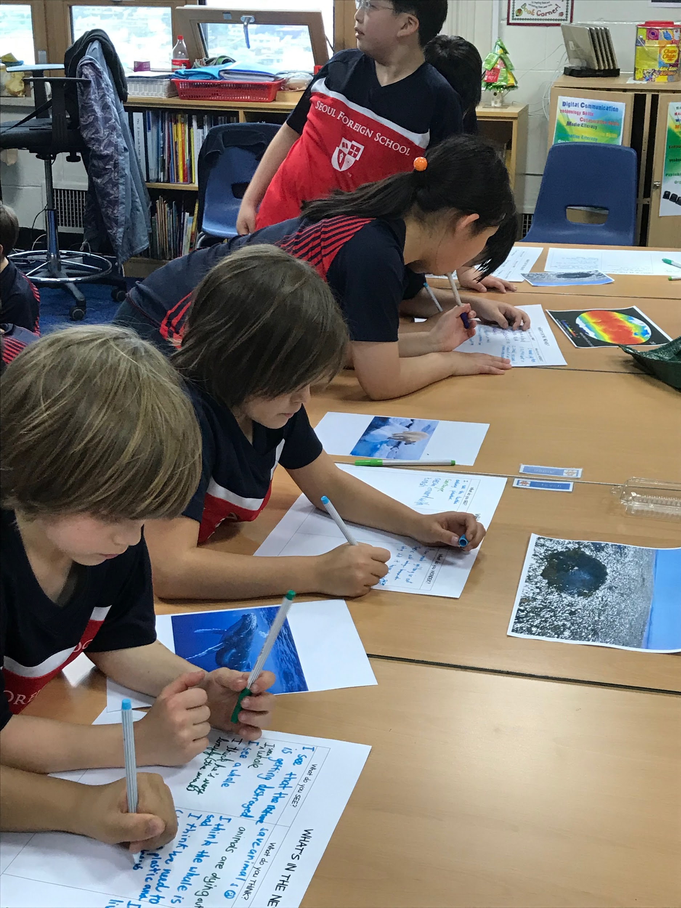
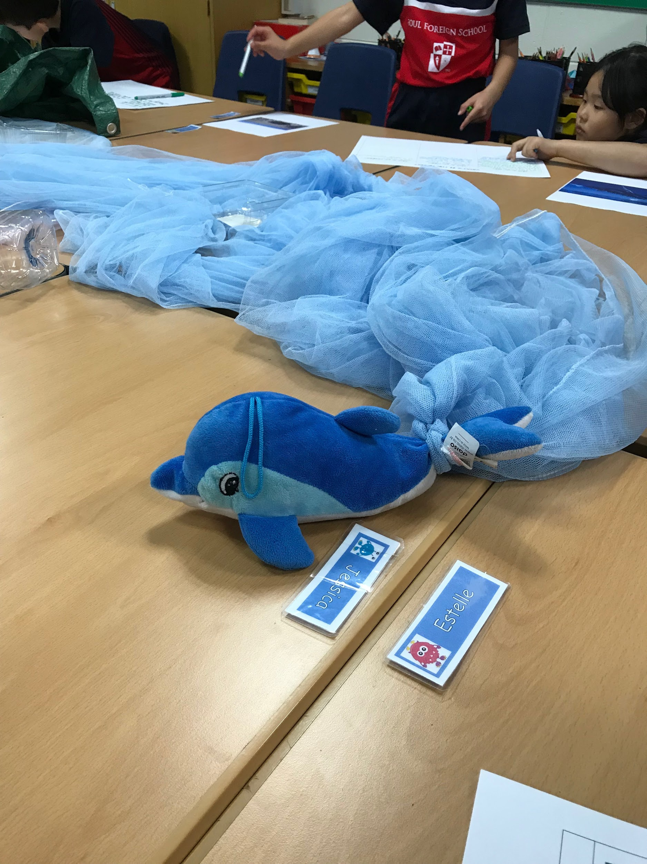
So many thoughts and questions arose afterwards… many still wonder why not enough is being done and what can we do?

