Slide 1
A plastic soup..
What`s the problem?
The second class
Secondary School Constanatin Brancusi
Bucharest, Romania
Coordinator, teacher Cornelia Bataus

Slide 2
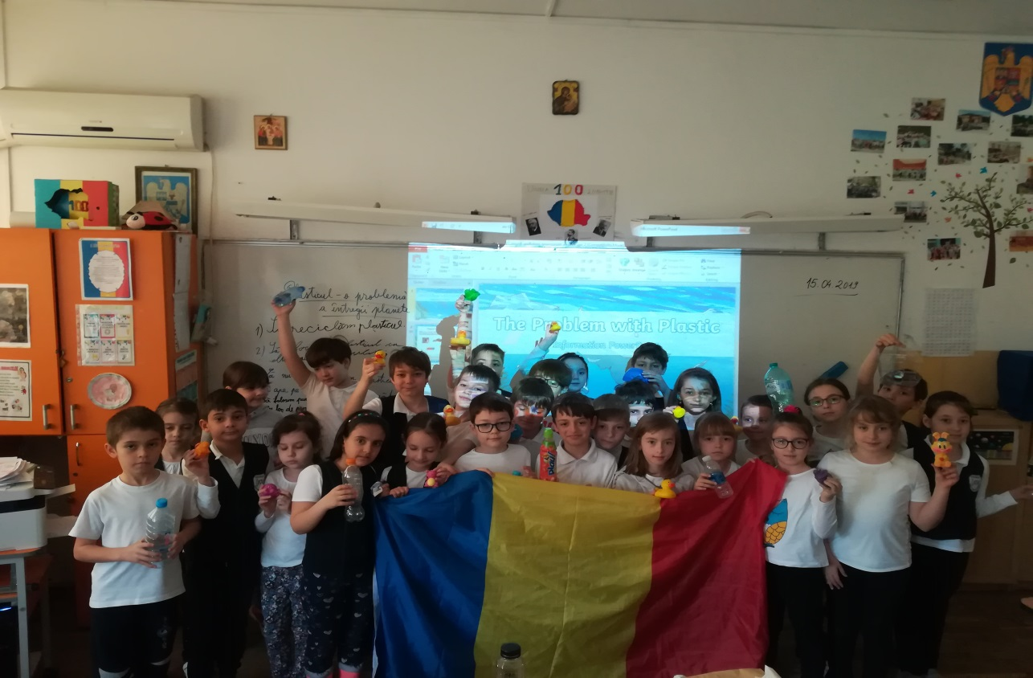
My students

Slide 3
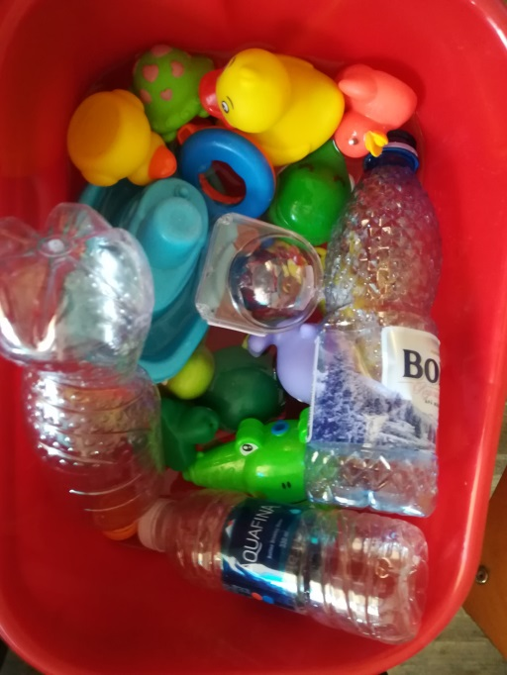
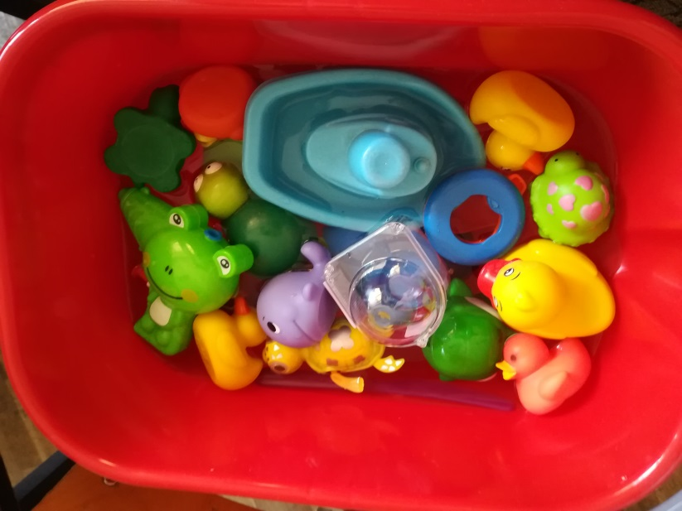
Plastic soup in the ocean

Slide 4
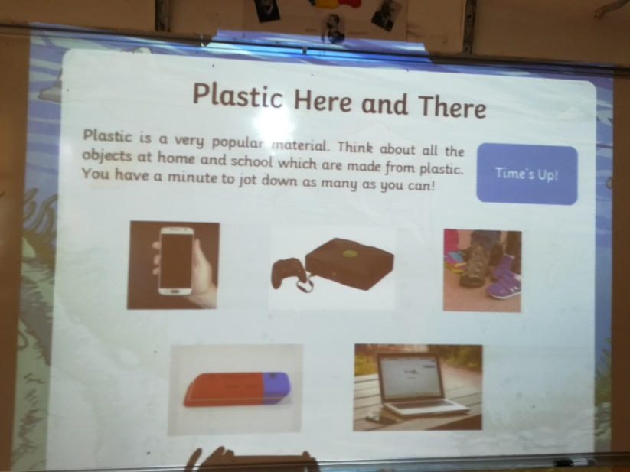
Plastic here and there
We find plastic everywhere. Every object is from plastic.
My students play with toys plastic in a pot . We had a plastic soup….They brought ducks, fish, boats toys and many bottles of plastic. They discussed about this situation in a real life. In the ocean, a lot of animals die of plastic.

Slide 5
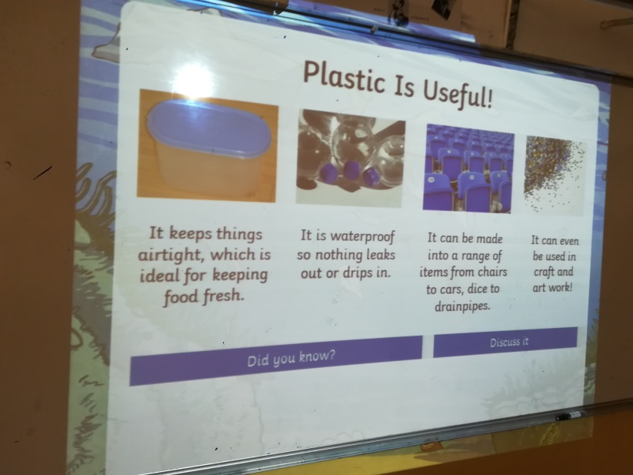
Plastic is useful, but….
We had a lesson about advantages and disadvantages of using plastic.
We realize that the plastic is neccesary, but we can use natural materials that don`t pl\ollute the environment.

Slide 6
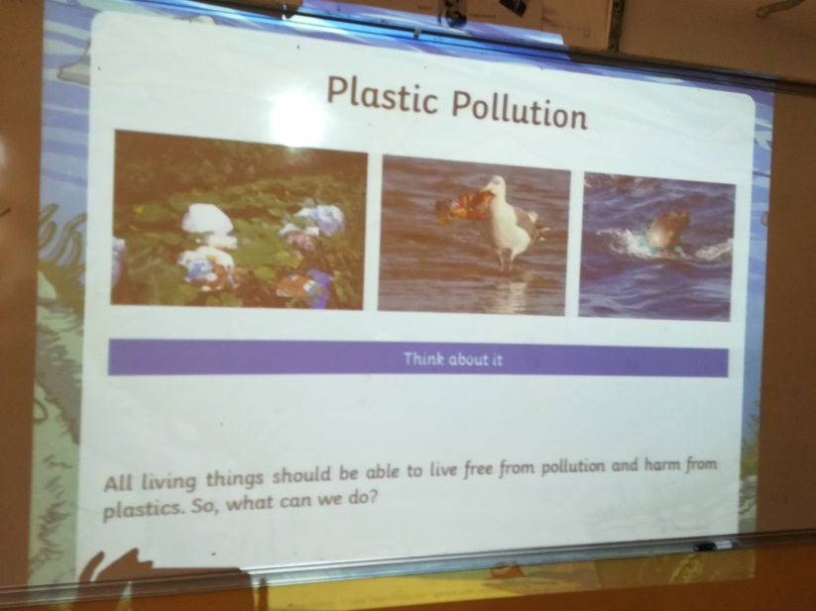
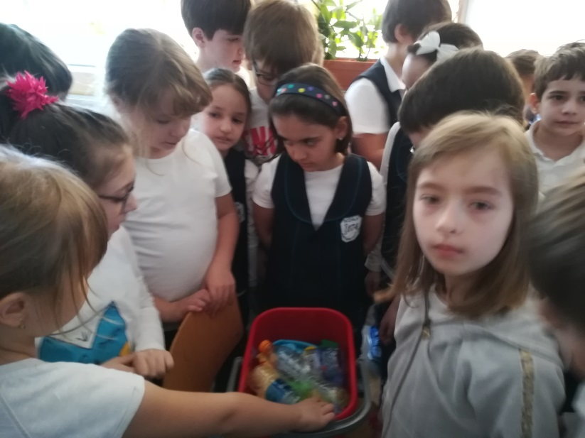
Plastic pollution

Slide 7
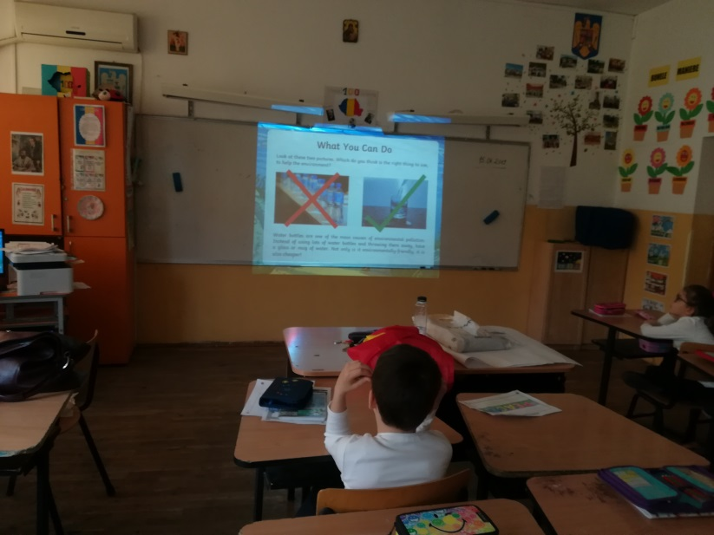
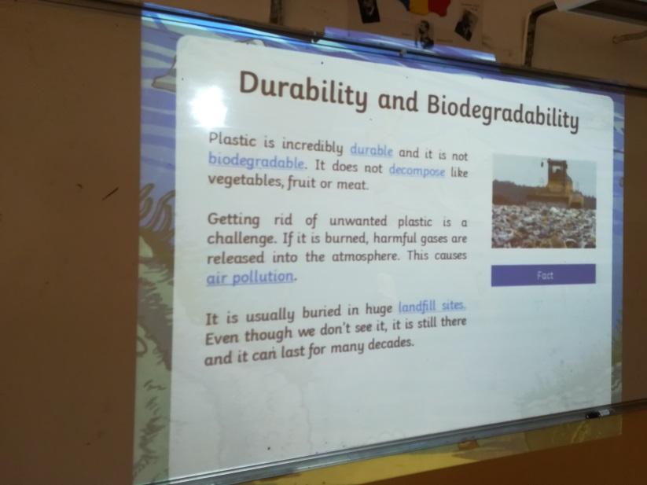
Durability and biodegradability

Slide 8
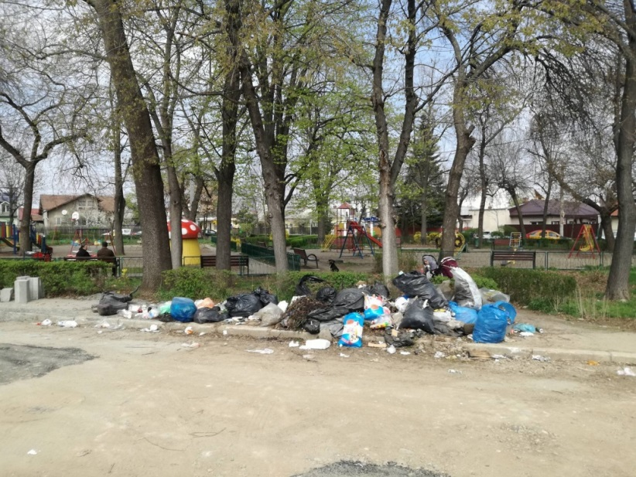
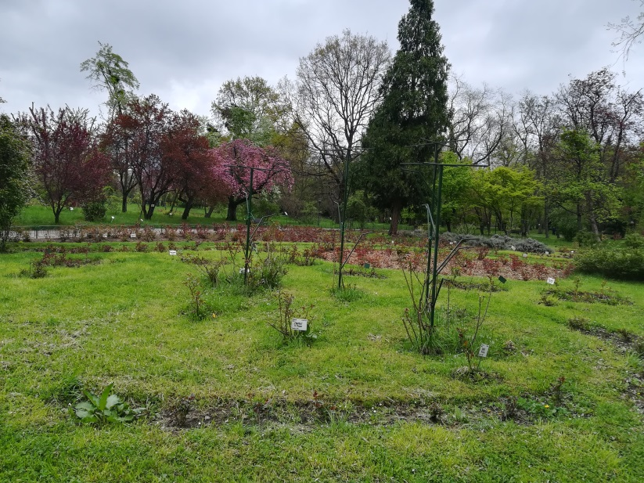
Let`s do something!

